Slide 1
WELCOME

Slide 2
STUDIES ON STRUCTURE-ACTIVITY RELATIONSHIPS OF SOME ACTIVATED ALKENES
Researcher supervisor
P.MOHANDASS DR K.RADHAKRISHNAN
ASSOCIATE PROFESSOR ASSOCIATE PROFESSOR
PG AND RESEARCH DEPARTMENT OF CHEMISTRY PG AND RESEARCH DEPARTMENT OF CHEMISTRY
SARASWATHI NARAYANAN COLLEGE SARASWATHI NARAYANAN COLLEGE
MADURAI-22 MADURAI-22

Slide 3
CHAPTER I
INTRODUCTION

Slide 4
CHAPTER I
CORRELATION ANALYSIS
For summarizing and analyzing the huge data involves the use of empirical correlations by which the results can be related to another. The data may thus be analyzed to reveal the fundamental factors underlying organic chemistry.
Empirical correlations of the reactivities of organic compounds are usually linear relationships involving logarithms of rate k or equilibrium K constants. These relationships are numerous and important that the term linear free-energy relationships (LFER)
is very often used to cover the whole field of correlation analysis in organic chemistry.

Slide 5
CHAPTER I
THE HAMMETT EQUATION
log k/ kº = ρσ ; log K/ Kº = ρσ
k and K are the rate and equilibrium constants for meta- or para- substituted benzene derivatives
kº and Kº are the rate constant and equilibrium constants for unsubstituted benzene derivatives
σ - substituent constant measures the polar effect relative to hydrogen as a substituent in
the meta- or para- position and is independent of the reaction.
ρ – reaction constant and measures the susceptibility of the reaction to polar effects
depends on the nature of the reaction.

Slide 6
CHAPTER I
DUAL SUBSTITUENT PARAMETER TREATMENT (TAFT’S DSP)
log (k/kº) = ρ_{I} σ_{I} + ρ_{R} σ_{R}
σ_{I} - _{Inductive substituent constant}
σ_{R} - _{Resonance substituent constant}

Slide 7
Swain – lupton treatment
In this two parameter treatment the polar effect of any given substituent has been expressed in terms of a field constant, F and a resonance constant, R. All the various σ constants are the linear combinations of F and R of the form
σ = fF + rR
f and r are the weighting factors of field and resonance effects

Slide 8
CHAPTER I
YUKAWA-TSUNO EQUATION
log k/ kº = ρ[σ + r (σ⁺ - σ ) ]
for more electron demanding than the ionization of benzoic acids
(σ⁺ - σ ) scale of enhanced resonance effect; r-proportionality constant
log k/ kº = ρ[σ +r (σ⁻ - σ ) ]
for less electron demanding than the ionization of benzoic acids
(σ⁻ - σ ) scale of enhanced resonance effect; r-proportionality constant

Slide 9
CHAPTER I
ortho-Effect
log (k/kº) = ρ* σ _{o}* + δ E_{s}
σ _{o}* is the ortho-substituent constant
E_{s} is the steric substituent constant
δ is the susceptibility constant

Slide 10
CHAPTER I
TRIPLE SUBSTITUENT PARAMETER (TSP)
Separation of polar, resonance and steric effect given by Charton
log k = α σ_{I} + β σ_{R} + φ ν + h
α- localized component; β-delocalized component
φ- coefficient of steric; h-intercept
σ_{I} - inductive substituent constant; σ_{R} - resonance substituent constant
ν-steric parameter

Slide 11
SCOPE OF THE PRESENT WORK
PREPARATION AND CHARACTERIZATION OF
i) 4′-substituted 2-benzylidene-1,3-indandiones.
ii) 4′-substituted 5-benzylidenebarbituric acids.
iii) 4′-substituted (E)-1-(furan-2-yl)-3-phenylprop-2-ene-1-one
CORRELATION WITH SPECTROSCOPIC DATA
CORRELATION WITH INHIBITION ZONE
CORRELATION WITH E_{p} and E_{P}^{1/2}

Slide 12
CHAPTER 2
EXPERIMENTAL SECTION

Slide 13
CHAPTER 2
Preparation of 4′-substituted 2-benzylidene-1,3-indandiones

Slide 14
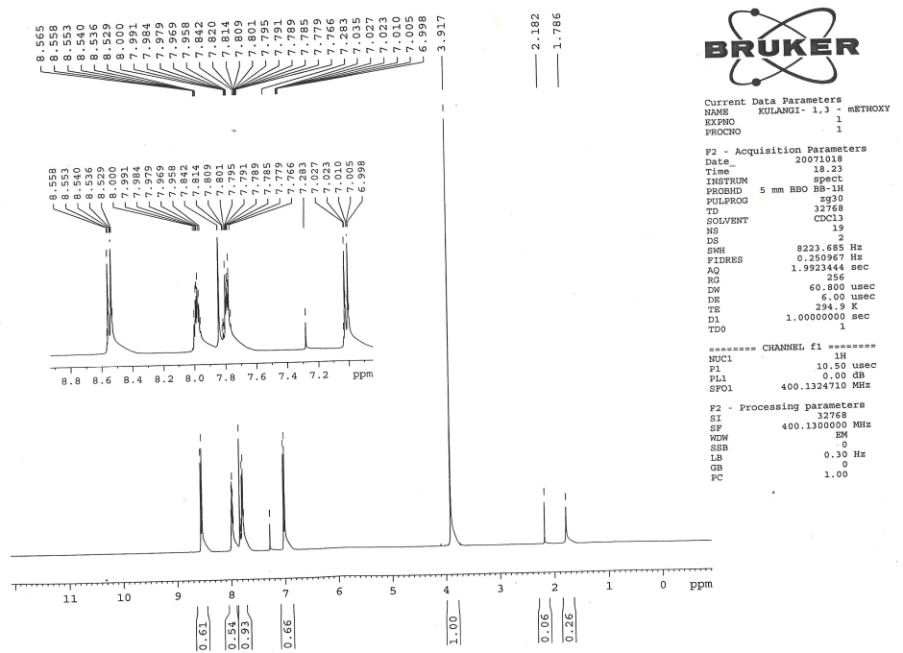

¹H NMR spectra of 2-(4′-methoxybenzylidene)-1,3-indandione

Slide 15
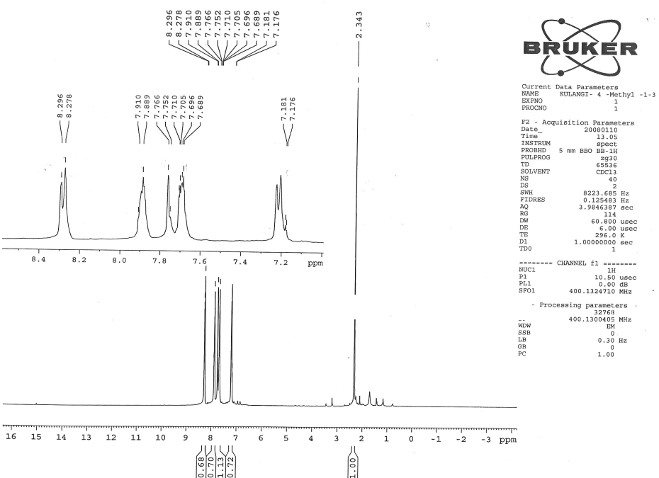
¹H NMR spectra of 2-(4′-methylbenzylidene)-1,3-indandione

Slide 16
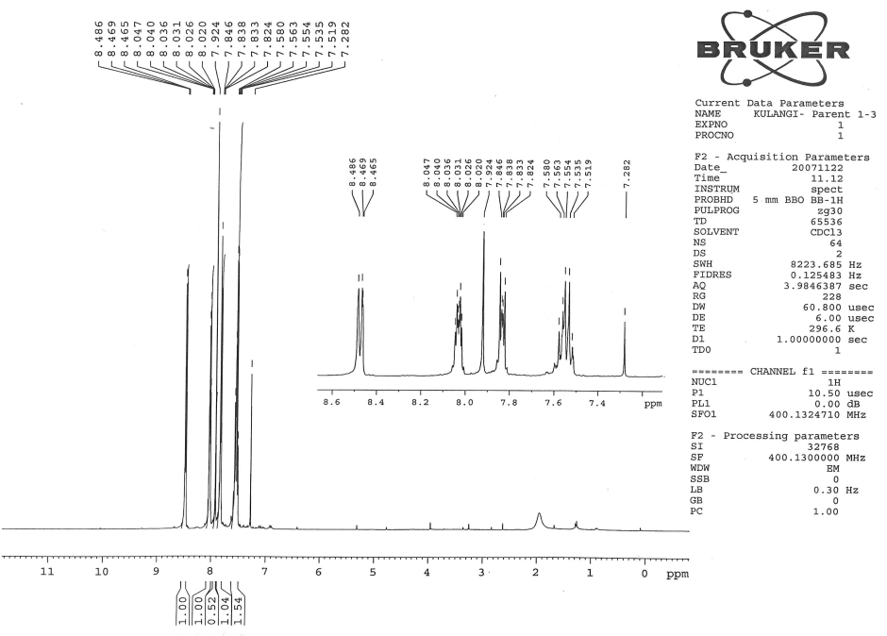
¹H NMR spectra of 2-benzylidene-1,3-indandione

Slide 17
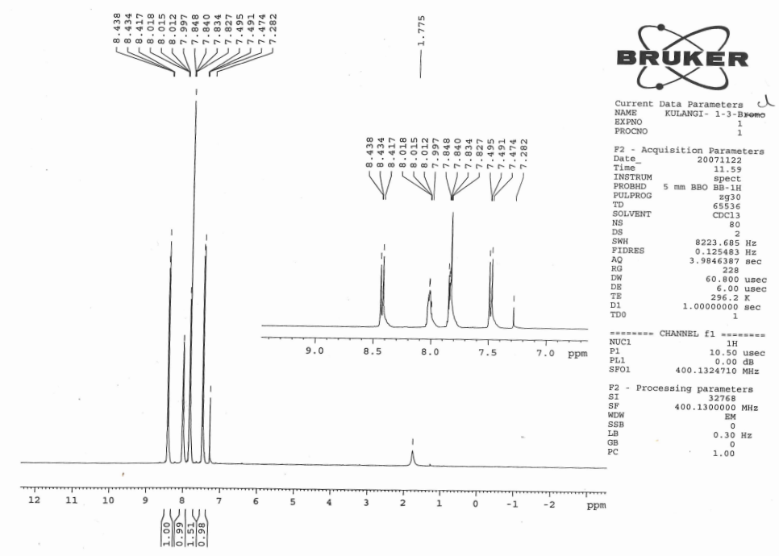
¹H NMR spectra of 2-(4′-chlorobenzylidene)-1,3-indandione

Slide 18
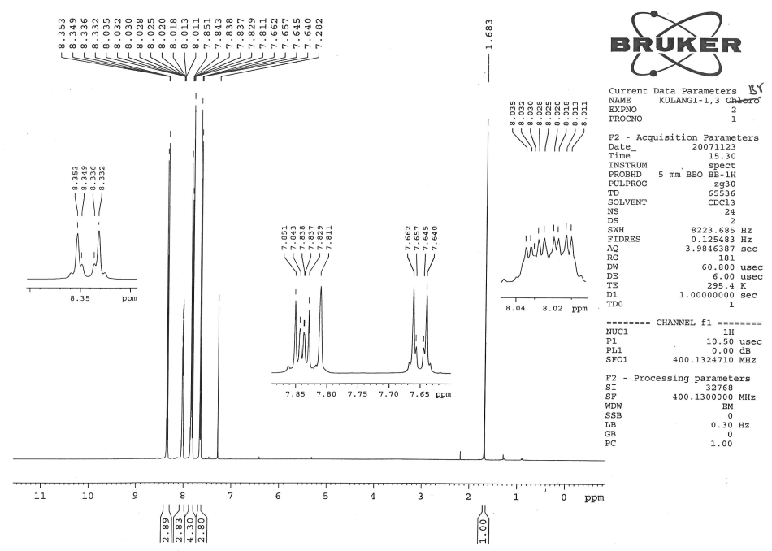
¹H NMR spectra of 2-(4′-bromobenzylidene)-1,3-indandione

Slide 19
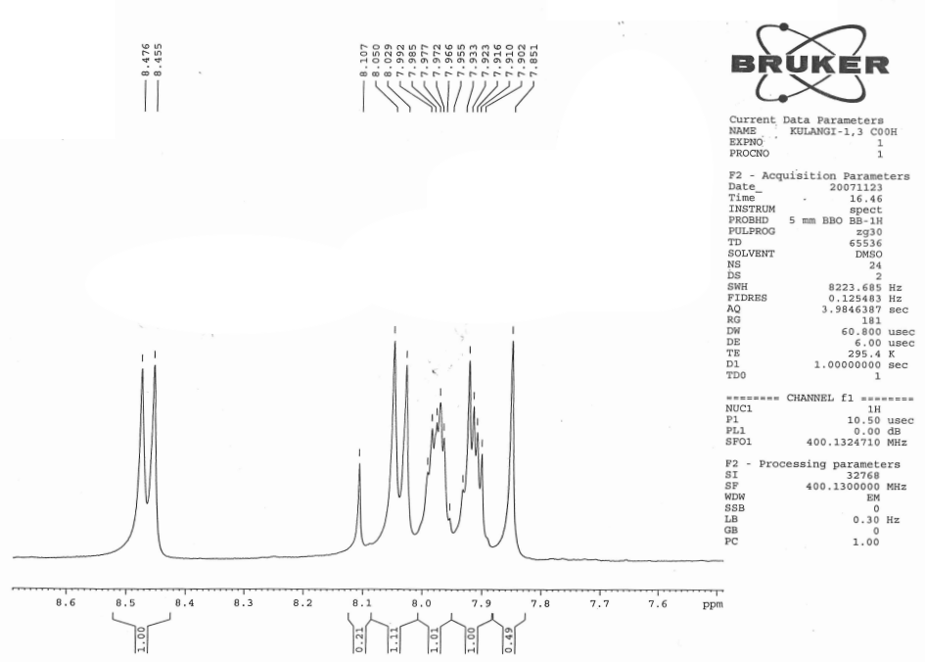
¹H NMR spectrum of 2-(4′-carboxybenzylidene)-1,3-indandione

Slide 20
¹H NMR chemical shift data for 2-benzylidene-1,3-indandiones
2-(4′-Methoxybenzylidene)-1,3-indandione: δ 3.917(s,3H), 6.998-7.027(m,2H), 7.766-7.842(m,2H),
7.842(s,1H),7.958-8.000(m,2H), 8.529-8.558(m,2H).
2. 2-(4′-Methylbenzylidene)-1,3-indandione: δ 2.343(s,3H), 7.178(d,2H), 7.689 - 7.710(m,2H),
7.766(s,1H),7.899(dd,1H), 8.287(d,1H).
3. 2-Benzylidene-1,3-indandione: δ 7.519-7.580(m,4H), 7.824-7.846(m,2H), 7.9249(s,1H),
8.020-.8047(m,2H), 8.465-8.4869(dd,2H).
4. 2-(4′-Chlorobenzylidene)-1,3-indandione: δ 7.474-7.495(m,2H), 7.834-7.848(m,2H), 7.827(s,1H),
7.997- 8.018(m,2H), 8.417-8.438(m,2H).
5. 2-(4′-Bromobenzylidene)-1,3-indandione: δ 7.640-7.662(dd,2H), 8.322-8.353(dd,2H), 7.811(s,1H),
8.011- 8.035(m,2H), 7.829-7.851(m,2H).
6. 2-(4′-Carboxybenzylidene)-1,3-indandione: δ 7.851(s,1H), 7.902-7.923(m,2H), 7.955-7.992(m,2H),
8.039(d,2H), 8.465(d,2H).

Slide 21
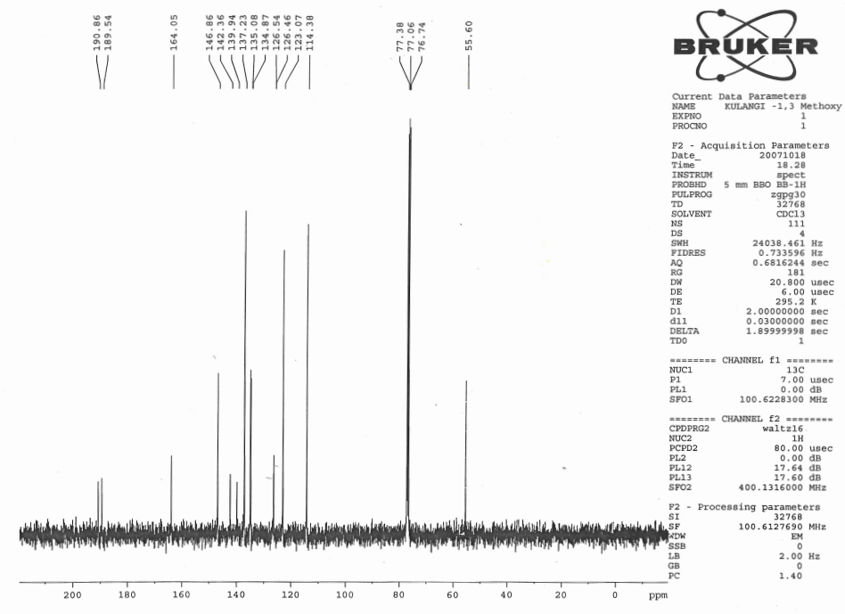
¹³C NMR spectrum of 2-(4′-methtoxybenzylidene)-1,3-indandione

Slide 22
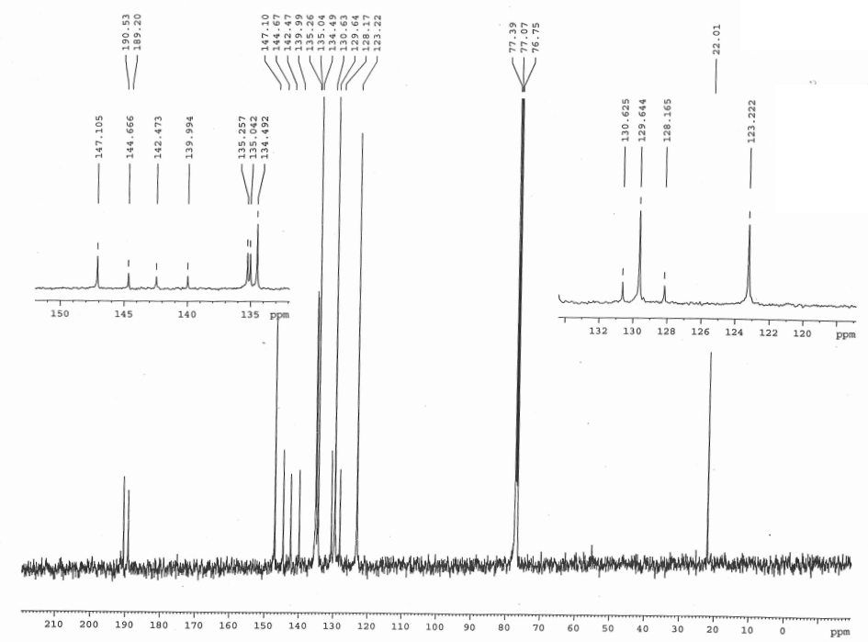
¹³C NMR spectrum of 2-(4′-methylbenzylidene)-1,3-indandione

Slide 23
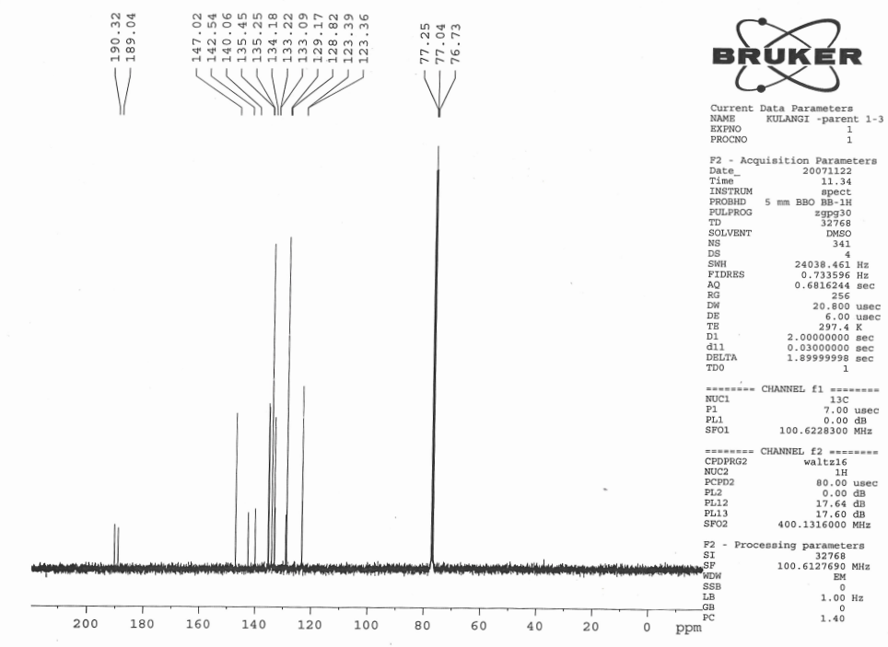
¹³C NMR spectrum of 2-benzylidene-1,3-indandione

Slide 24
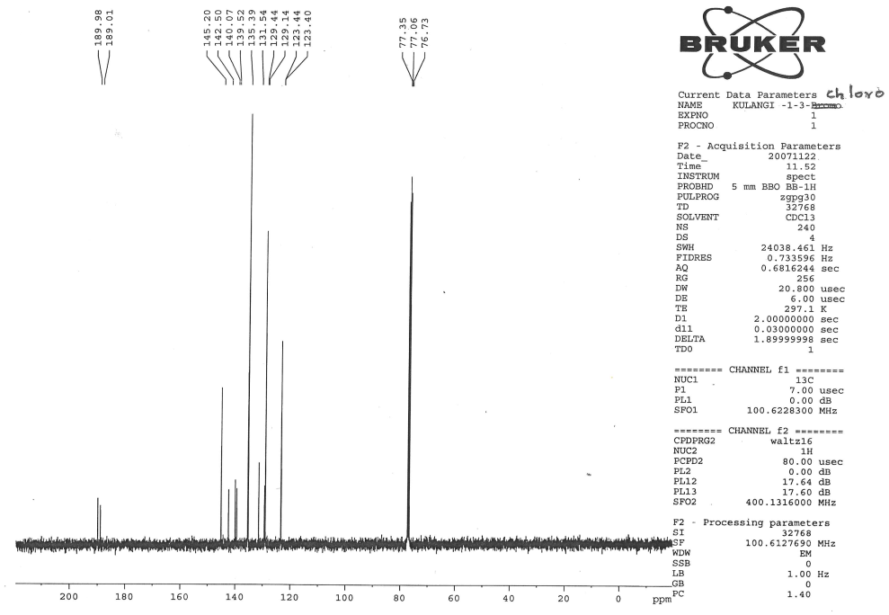
¹³C NMR spectrum of 2-(4′-chlorobenzylidene)-1,3-indandione

Slide 25
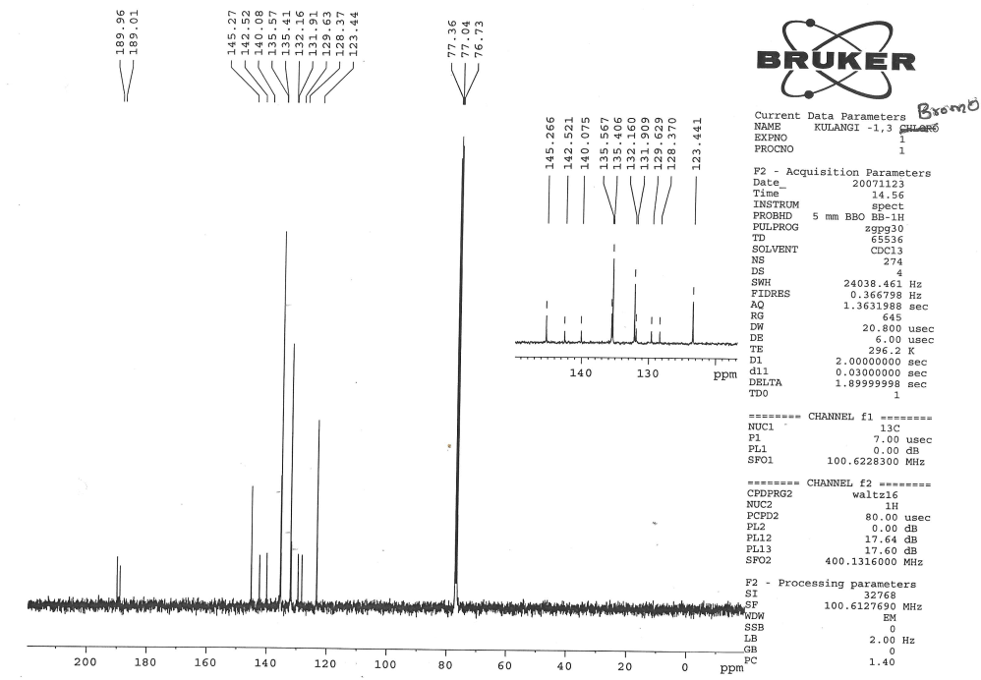
¹³C NMR spectrum of 2-(4′-bromobenzylidene)-1,3-indandione

Slide 26
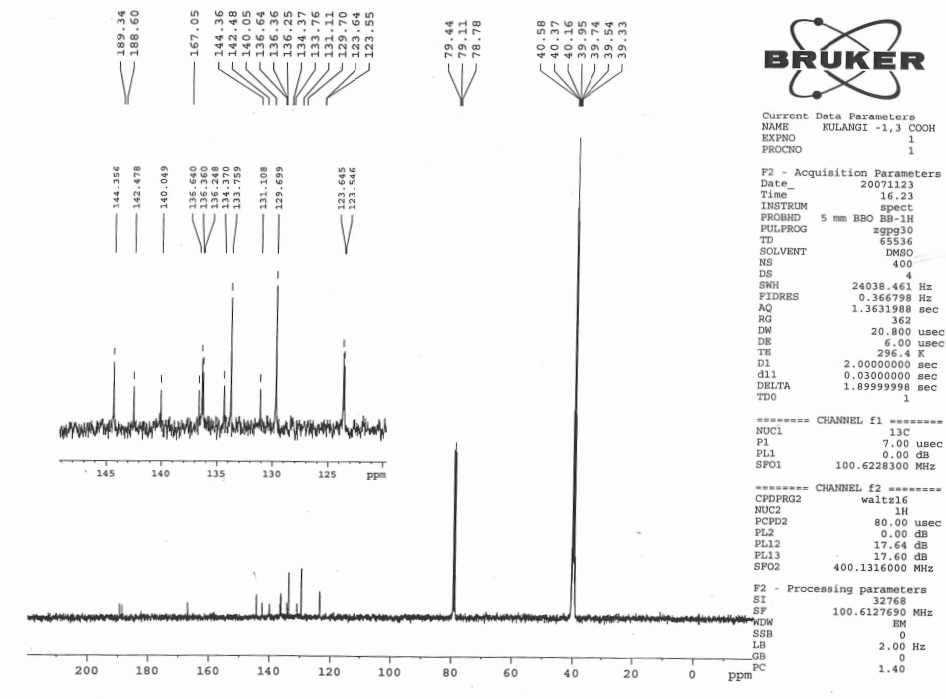
¹³C NMR spectrum of 2-(4′-carboxybenzylidene)-1,3-indandione

Slide 27
¹³C NMR spectral data of 4′-substituted 2-benzylidene-1.3-indandiones
1. 2-(4′-Methtoxybenzylidene)-1,3-indandione: δ 55.60, 114.38, 123.07, 126.46, 126.54,
134.87, 135.08, 137.23, 139.94, 142.36, 146.86, 164.05, 189.54, 190.86.
2. 2-(4′-Methylbenzylidene)-1,3-indandione: δ 22.01, 123.22, 128.17, 129.64, 130.63,
134.49, 135.04, 135.26, 139.99, 142.47, 144.67, 147.10, 189.20, 190.53.
3. 2-Benzylidene-1,3-indandione: δ 123.36, 123.39, 128.82, 129.17, 133.09, 133.22, 134.18,
135.25, 135.45, 140.06, 142.54, 147.02, 189.04, 190.32.
4. 2-(4′-Chlorobenzylidene)-1,3-indandione: δ 123.40, 123.44, 129.14, 129.44, 131.54,
135.39, 139.52, 140.07, 142.50, 145.20, 189.01, 189.98.
5. 2-(4′-Bromobenzylidene)-1,3-indandione: δ 123.44, 128.37, 129.63, 131.91, 132.16,
135.41, 135.57, 140.08, 142.52, 145.27, 189.01, 189.96.
6. 2-(4′-Carboxybenzylidene)-1,3-indandione: δ 123.55, 123.64, 129.70, 131.11, 133.76,
134.37, 136.25, 136.36, 136.64, 140.05, 142.48, 144.36, 167.05, 188.60, 189.34.

Slide 28
CHAPTER 2
Preparation of 4′-substituted 5-benzylidenebarbituric acids.

Slide 29
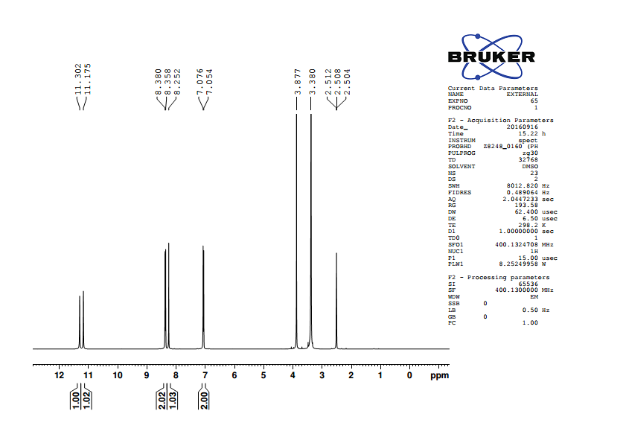
¹H NMR spectrum of 5-(4′-methoxybenzylidene)barbituric acid

Slide 30
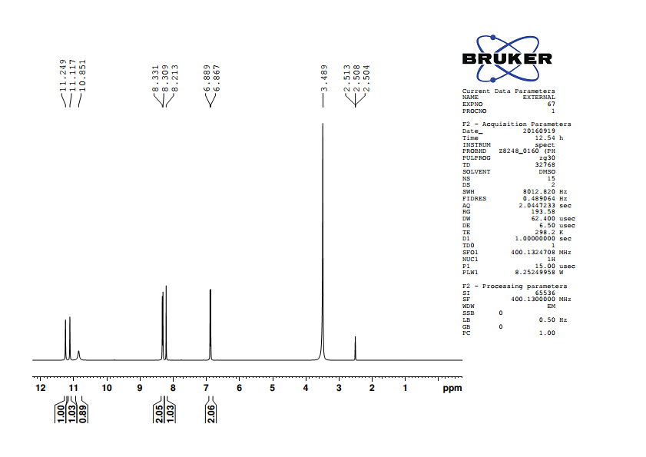
¹H NMR spectrum of 5-(4′-hydroxybenzylidene)barbituric acid

Slide 31
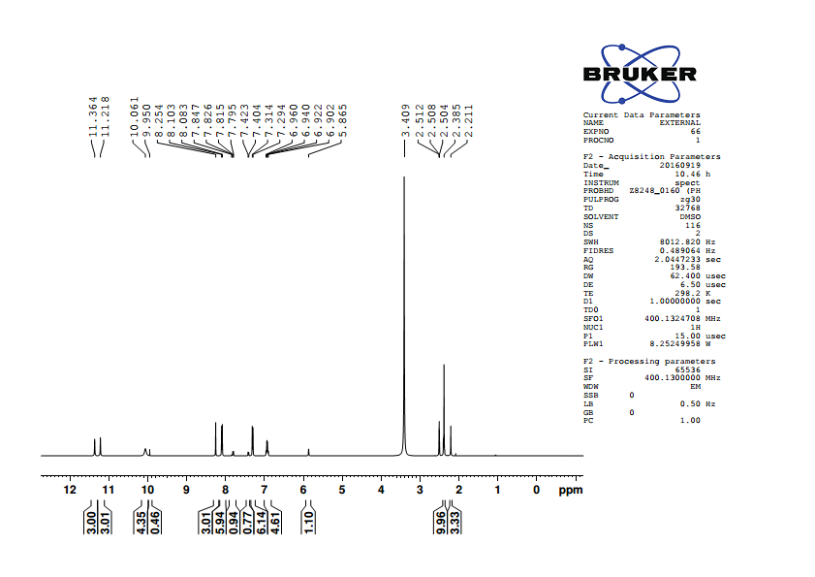
¹H NMR spectrum of 5-(4′-methylbenzylidene)barbituric acid

Slide 32
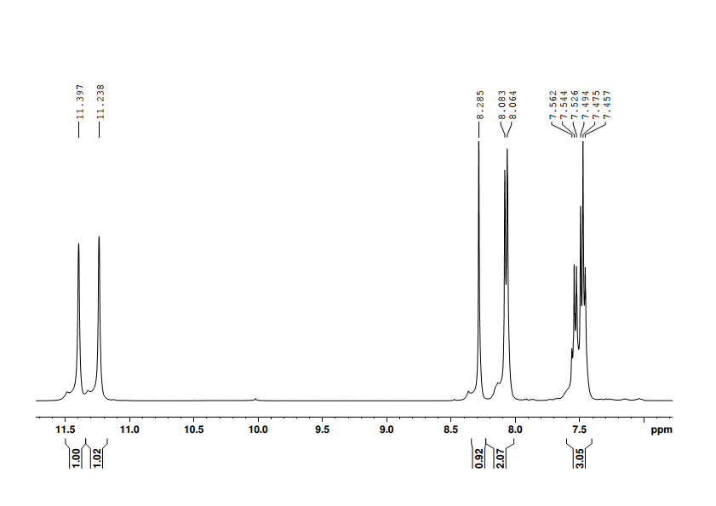
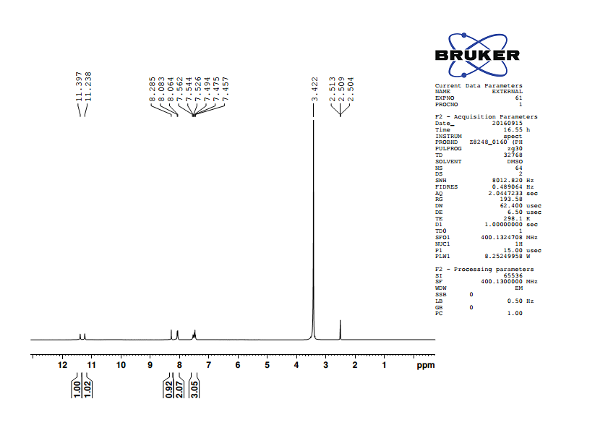
¹H NMR spectrum of 5-benzylidenebarbituric acid

Slide 33

¹H NMR spectrum of 5-(4′-chlorobenzylidene)barbituric acid

Slide 34
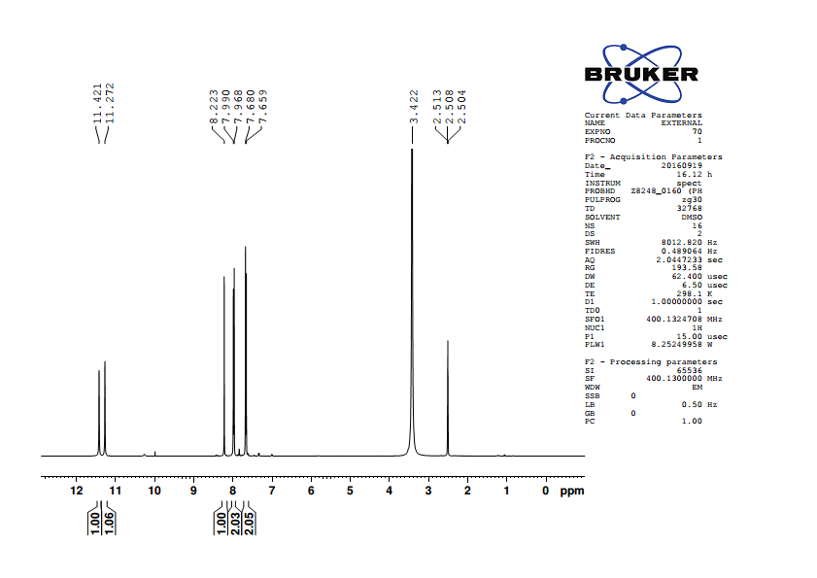
¹H NMR spectrum of 5-(4′-bromobenzylidene)barbituric acid

Slide 35
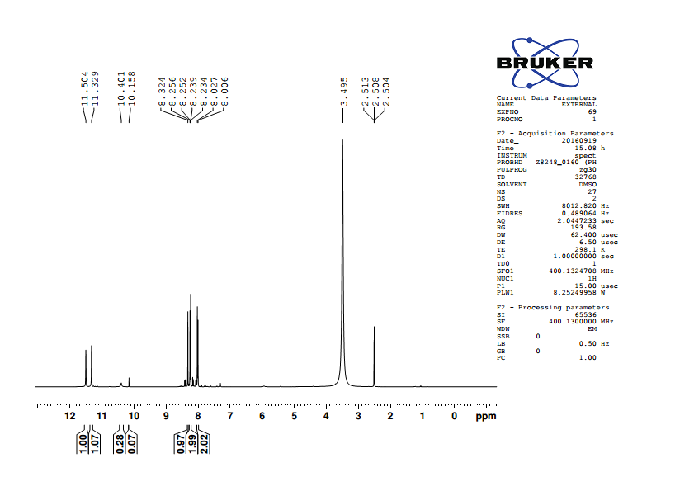
¹H NMR spectrum of 5-(4′-nitrobenzylidene)barbituric acid

Slide 36
¹H NMR Spectral data of 4′-substituted 5-benzylidenebarbituric acids
1. 5-(4′-Methoxybenzylidene)barbituric acid
δ 3.877 (s,3H), 7.065 (d,2H), 8.252(s,1H), 8.369 (d,2H), 11.175 (s,1H), 11.302 (s,1H).
2. 5-(4′-Hydroxybenzylidene)barbituric acid
δ 6.878 (d,2H), 8.213 (s,1H), 8.320 (d,2H), 10.851 (s,1H), 11.117(s,1H), 11.249 (s,1H).
3. 5-(4′-Methylbenzylidene)barbituric acid
δ 2.385 (s,3H), 7.304 (d,2H), 8.094 (d,2H), 8.255 (s,1H), 11.218 (s,1H), 11.365 (s,1H).
4. 5-Benzylidenebarbituric acid
δ 7.485 (m,3H), 8.073 (d,2H), 8.285 (s,1H), 11.238 (s,1H), 11.397 (s,1H).
5. 5-(4′-Chlorobenzylidene)barbituric acid
δ 7.518 (d,2H), 8.069 (d,2H), 8.243 (s,1H), 11.275 (s,1H), 11.425 (s,1H).
6. 5-(4′-Bromobenzylidene)barbituric acid
δ 7.670 (d,2H), 7.979 (d,2H), 8.223 (s,1H), 11.272 (s,1H), 11.421 (s,1H).
7. 5-(4′-Nitrobenzylidene)barbituric acid
δ 8.017 (d,2H), 8.245 (d,2H), 8.324 (s,1H), 11.329 (s,1H), 11.504 (s,1H).

Slide 37
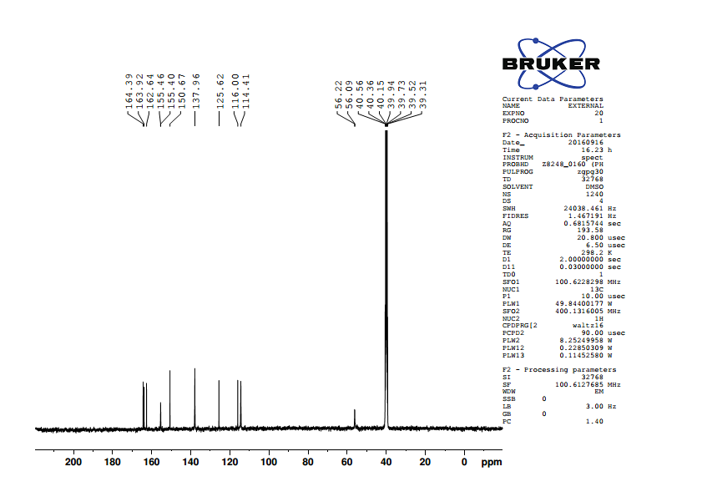
¹³C NMR spectrum of 5-(4′-methoxybenzylidene)barbituric acid

Slide 38

¹³C NMR spectrum of 5-(4′-hydroxybenzylidene)barbituric acid

Slide 39
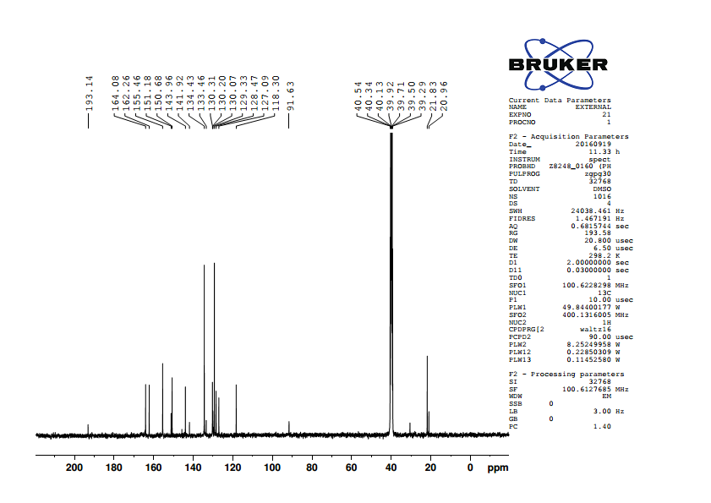
¹³C NMR spectrum of 5-(4′-methylbenzylidene)barbituric acid

Slide 40
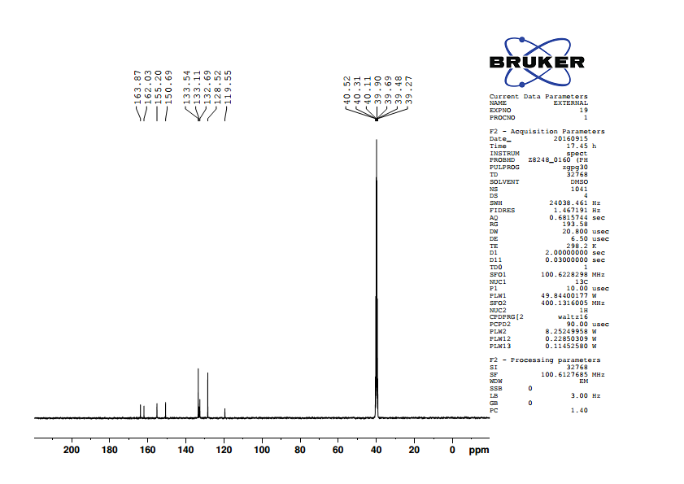
¹³C NMR spectrum of 5-benzylidenebarbituric acid

Slide 41

¹³C NMR spectrum of 5-(4′-chlorobenzylidene)barbituric acid

Slide 42

¹³C NMR spectrum of 5-(4′-bromobenzylidene)barbituric acid

Slide 43
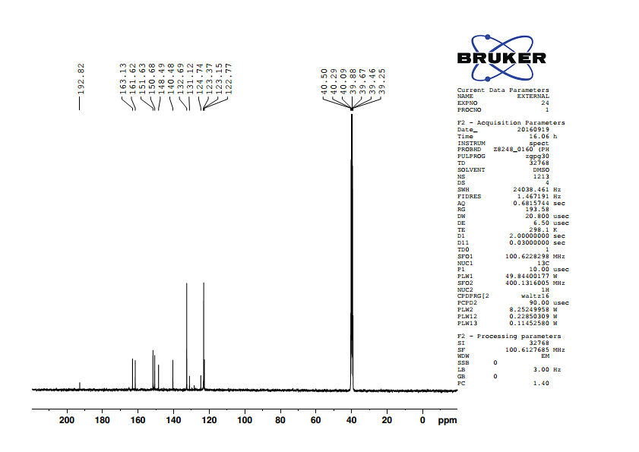
¹³C NMR spectrum of 5-(4′-nitrobenzylidene)barbituric acid

Slide 44
¹³C NMR Spectral data of 4′-substituted 5-benzylidenebarbituric acids
1. 5-(4′-Methoxybenzylidene)barbituric acid
δ 56.22, 114.41, 116.00, 125.62, 137.96, 150.67, 155.46, 162.64, 163.92, 164.39
.
2. 5-(4′-Hydroxybenzylidene)barbituric acid
δ 114.61, 115.97, 124.24, 138.77, 150.70, 156.05, 162.75,163.48, 164.59
.
3. 5-(4′-Methylbenzylidene)barbituric acid
δ 118.30, 129.33, 130.31, 134.43, 143.96, 150.68, 155.46, 162.26, 164.08.
4. 5-Benzylidenebarbituric acid
δ 119.55, 128.52, 132.69, 133.11, 133.54, 150.69, 155.20, 162.03, 163.87.
5. 5-(4′-Chlorobenzylidene)barbituric acid
δ 120.09, 128.55, 132.01, 135.15, 137.21, 150.65, 153.52, 162.04, 163.67
.
6. 5-(4′-Bromobenzylidene)barbituric acid
δ 120.24, 126.29, 131.51, 132.40, 135.15, 150.65, 153.56, 162.04, 163.67.
5-(4′-Nitrobenzylidene)barbituric acid
δ 123.15, 123.37, 132.69, 140.48, 148.49, 150.68, 151.63, 161.62, 163.13.

Slide 45
CHAPTER 2

Slide 46
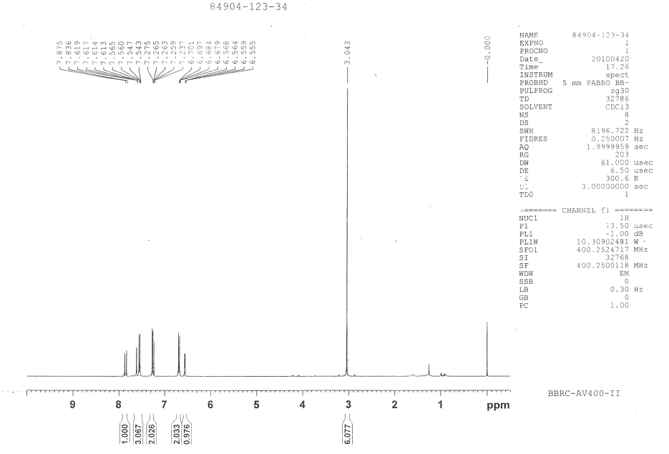
¹H NMR spectra of (E)-1-(furan-2-yl)-3-(4′ -N,N dimethylaminophenyl)prop-2-ene-1-one

Slide 47
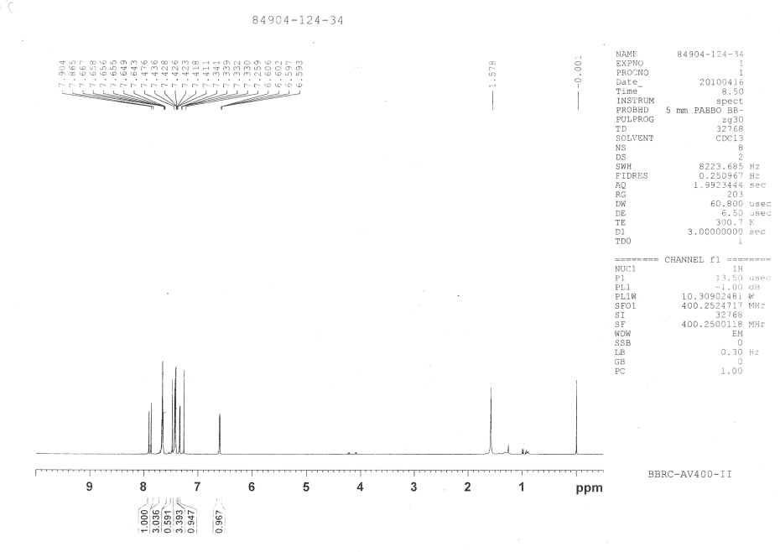
¹H NMR spectra of (E)-1-(furan-2-yl)-3-phenylprop-2-ene-1-one

Slide 48
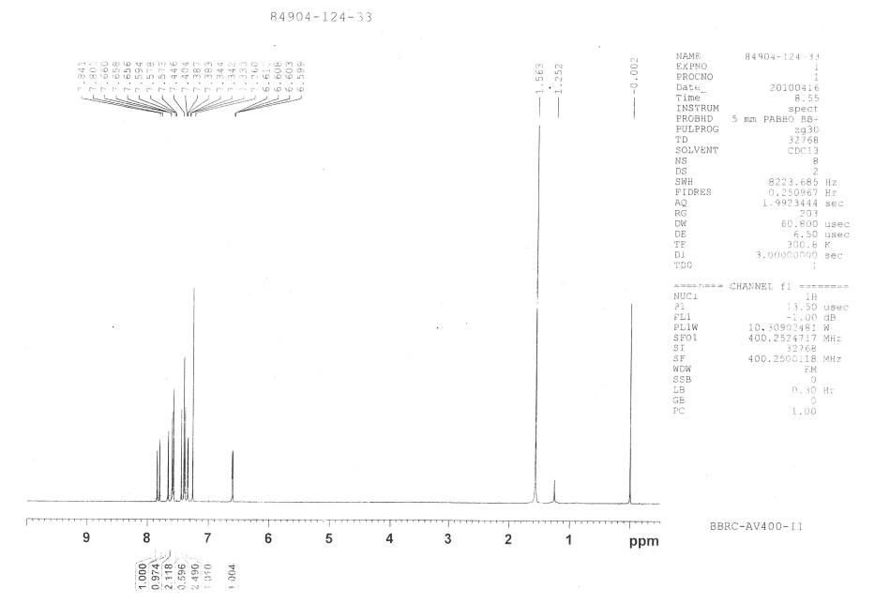
¹H NMR spectra of (E)-1-(furan-2-yl)-3-(4′-chlorophenyl)prop-2-ene-1-one

Slide 49
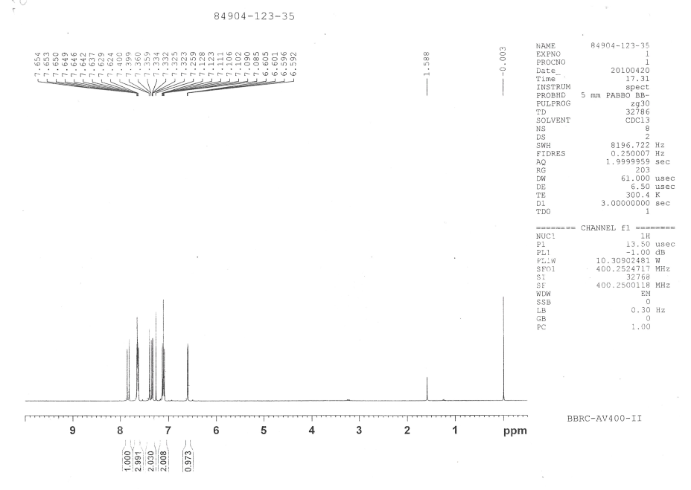
¹H NMR spectra of (E)-1-(furan-2-yl)-3-(4′ -fluorophenyl)prop-2-ene-1-one

Slide 50
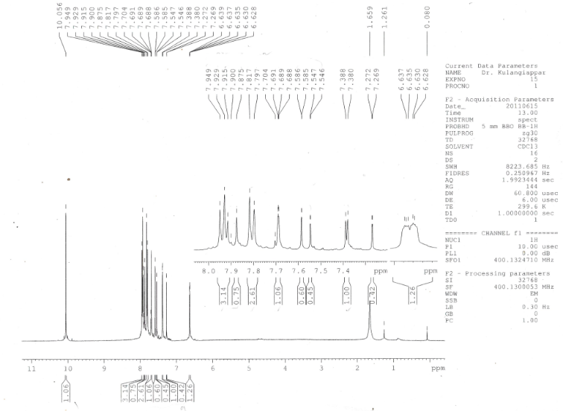
¹H NMR spectra of (E)-1-(furan-2-yl)-3-(4′-methanoylphenyl)prop-2-ene-1-one

Slide 51
¹H NMR spectral data of (E)-1-(furan-2-yl)-3-phenylprop-2-ene-1-ones
(E)-1-(Furan-2-yl)-3-(4′ -N,N dimethylaminophenyl)prop-2-ene-1-one δ 3.043(s,6H), 6.562 (d,d,1H), 6.690 (d,2H),7.256 (d,1H), 7.262 (d,1H), 7.554 (d,2H),7.616 (m,1H),7.856 (d,1H).
(E)-1-(Furan-2-yl)-3-(4′ -methylphenyl)prop-2-ene-1-one: δ 7.233(dd,1H), 7.330(d,1H), 7.561(d,2H), 7.421(d,1H), 7.233(d,2H), 7.872(d,1H), 7.656(m,1H), 2.401(s,3H).
(E)-1-(Furan-2-yl)-3-phenylprop-2-ene-1-one: δ 6.600 (dd,1H), 7.336 (d,1H), 7.421(m.2H), 7.423 (d,1H), 7.456(d,1H), 7.655(m,2H),7.657(m,1H), 7.885(d,1H).
(E)-1-(Furan-2-yl)-3-(4′-chlorophenyl)prop-2-ene-1-one: δ 6.606(d,d,1H), 7.339(d,1H), 7.394(d,2H), 7.425(d,1H), 7.584(d,2H), 7.584(d,2H), 7.658(m,1H), 7.822(d,1H).
(E)-1-(Furan-2-yl)-3-(4′ -fluorophenyl)prop-2-ene-1-one: δ 6.599 (dd,1H), 7.107(m,2H), 7.329(d,1H), 7.380(d,1H), 7.642(d,2H), 7.650(m,1H), 7.837(d,1H).
(E)-1-(Furan-2-yl)-3-(4′ -methanoylphenyl)prop-2-ene-1-one: δ 6.633(d,d 1H), 7.384(d,1H), 7.807(d,2H), 7.566(d,1H), 7.939(d,2H), 7.690(m,1H), 7.895(d,1H), 10.056(s,1H).

Slide 52
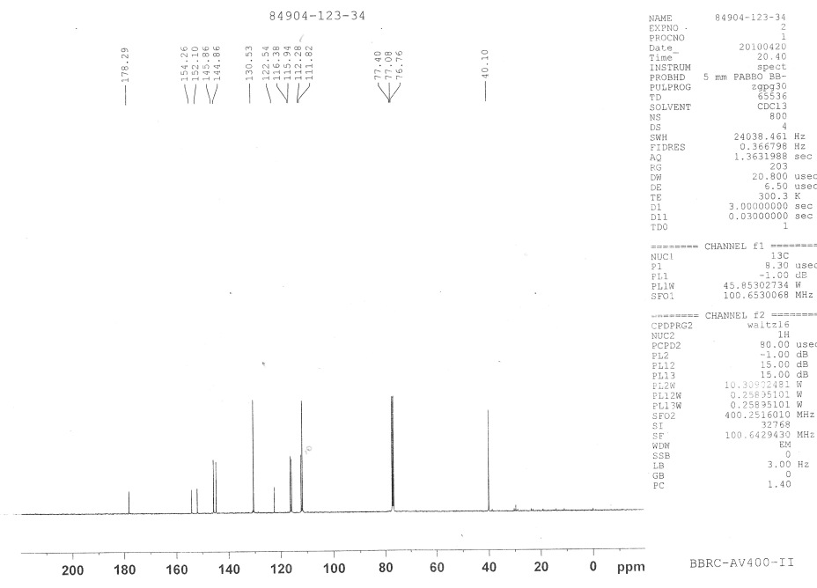
¹³C NMR spectra of (E)-1-(furan-2-yl)-3-(4′ -N,N dimethylaminophenyl)prop-2-ene-1-one

Slide 53
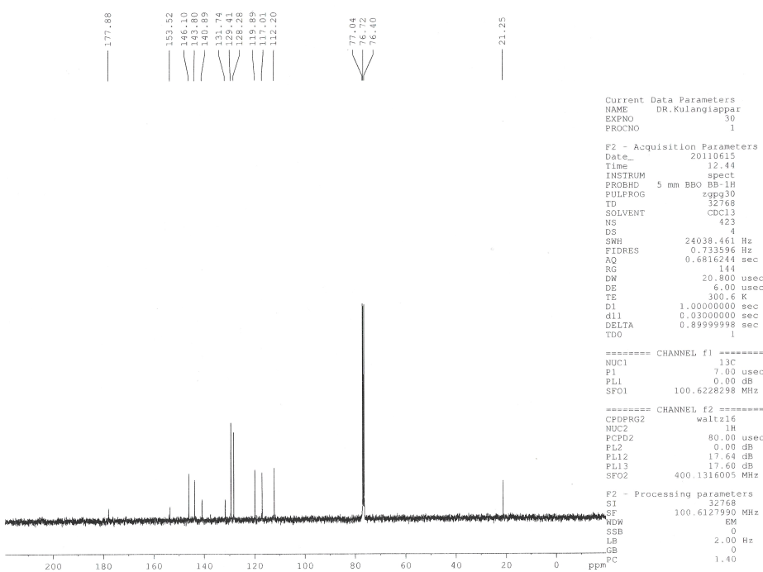
¹³C NMR spectra of (E)-1-(furan-2-yl)-3-(4′ -methylphenyl)prop-2-ene-1-one

Slide 54
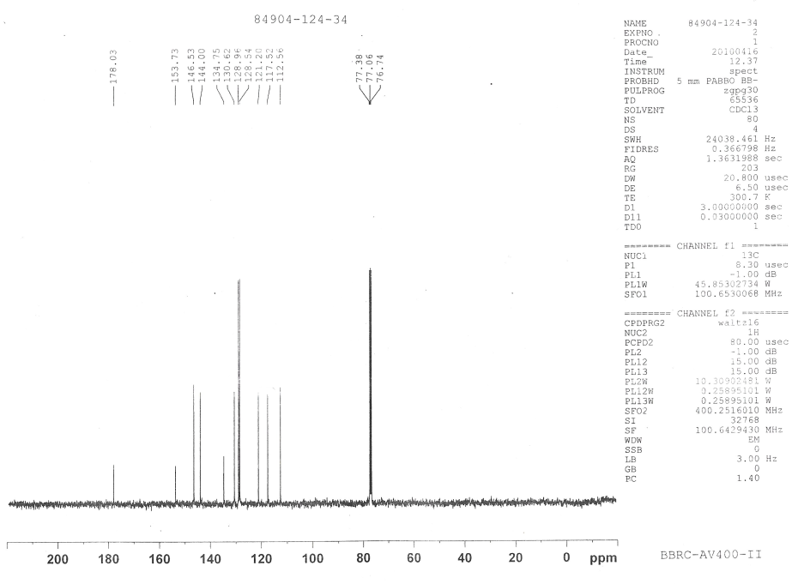
¹³C NMR spectra of (E)-1-(furan-2-yl)-3-phenylprop-2-ene-1-one

Slide 55
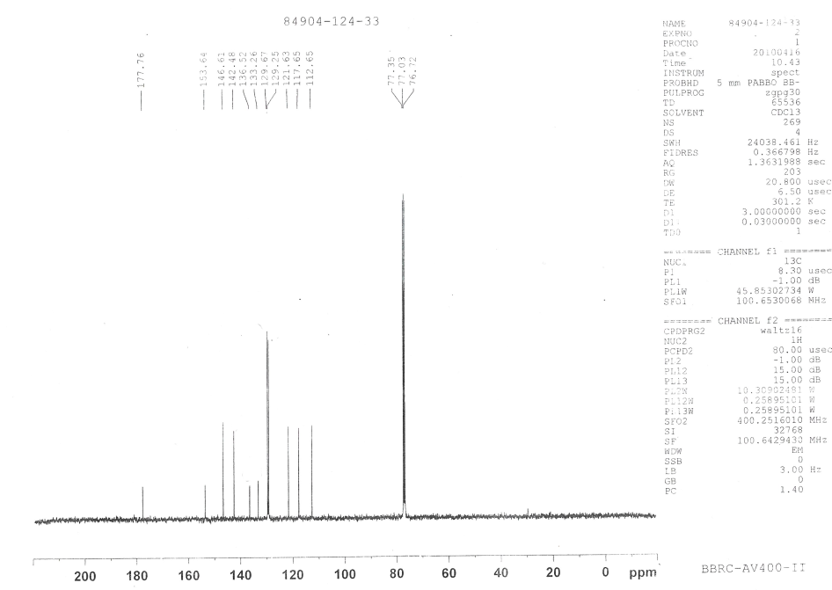
¹³C NMR spectra of (E)-1-(furan-2-yl)-3-(4′-chlorophenyl)prop-2-ene-1-one

Slide 56
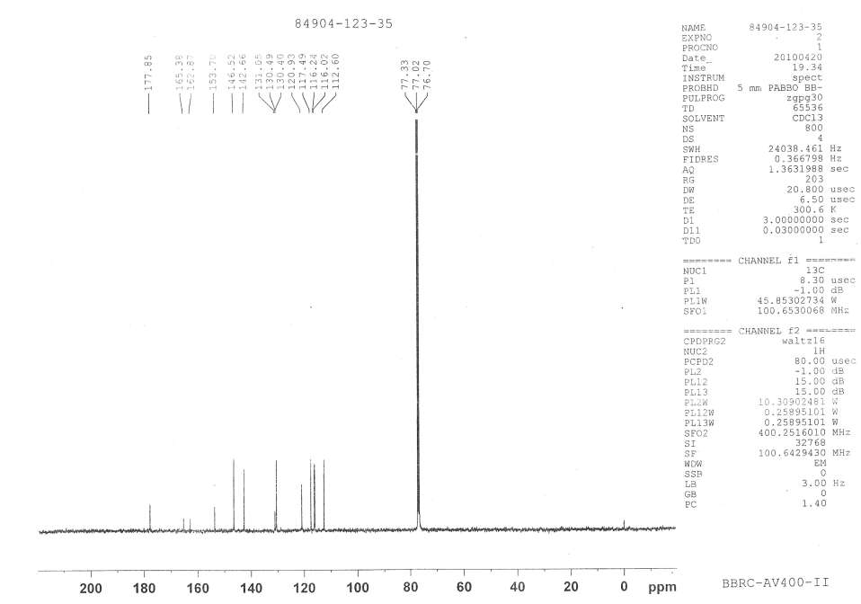
¹³C NMR spectra of (E)-1-(furan-2-yl)-3-(4′ -fluorophenyl)prop-2-ene-1-one

Slide 57
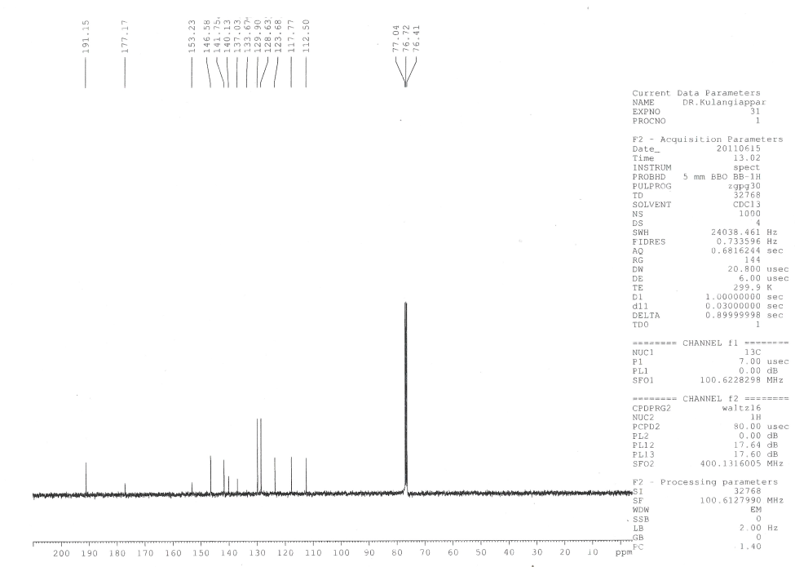
¹³C NMR spectra of (E)-1-(furan-2-yl)-3-(4′ -methanoylphenyl)prop-2-ene-1-one

Slide 58
¹³C NMR spectral data of 4’-substituted (E)-1-(furan-2-yl)-3-phenylprop-2-ene-1-ones
1. (E)-1-(Furan-2-yl)-3-(4′ -N, N dimethylaminophenyl) prop-2-ene-1-one
δ 111.82, 112.28, 115.94, 116.38, 122.54, 130.53, 144.86, 145.86, 152.10, 154.26, 178.29
2. (E)-1-(Furan-2-yl)-3-(4′ -methylphenyl) prop-2-ene-1-one
δ 12.20, 117.01, 119.89, 128.28, 129.41, 131.74, 140.89, 143.80, 146.10, 153.52, 177.88.
3. (E)-1-(Furan-2-yl)-3-phenylprop-2-ene-1-one
δ 112.56, 117.52, 121.20, 128.54, 128.96, 130.62, 134.75, 144.00, 146.53, 153.73,178.03
4. (E)-1-(Furan-2-yl)-3-(4′-chlorophenyl) prop-2-ene-1-one
δ 112.65, 117.65, 121.63, 129.25, 129.67, 133.26, 136.52, 142.48, 146.61, 153.64,177.76
5. (E)-1-(Furan-2-yl)-3-(4′ -fluorophenyl) prop-2-ene-1-one
δ 112.60, 116.02, 116.24, 117.49, 120.93, 130.40, 130.44, 142.66, 146.52, 153.70, 177.85
6. (E)-1-(Furan-2-yl)-3-(4′-methanoylphenyl) prop-2-ene-1-one
δ 112.50, 117.77, 123.68, 128.63, 129.90, 137.03, 140.13, 141.75, 146.58, 153.23, 177.17.

Slide 59
Chapter 3
Substituent effects on the ¹H and ¹³C NMR chemical shifts on
4′-substituted 5-benzylidenebarbituric acids.

Slide 60
CHAPTER 3
¹H NMR chemical shifts(ppm) of 4′-substituted 5-benzylidenebarbituric acids
S.No. | Substituent, -X | H₁ | H₃ | H₇ | H_{3′5′}
1. | -OCH₃ | 11.175 | 11.302 | 8.252 | 7.065
2. | -OH | 11.117 | 11.249 | 8.213 | 6.878
3. | -CH₃ | 11.218 | 11.365 | 8.255 | 7.304
4. | -H | 11.238 | 11.397 | 8.285 | 7.485
5. | -Cl | 11.275 | 11.425 | 8.243 | 7.518
6. | -Br | 11.272 | 11.421 | 8.223 | 7.670
7. | -NO₂ | 11.329 | 11.504 | 8.324 | 8.245

Slide 61
Results of statistical treatment of ¹H – Chemical shift with σ_{p}, σ_{p}º, σ_{p}⁺, σ_{p}⁺/ σ_{p}, σ_{p}⁺/ σ_{p}⁻, σ_{p}⁺/ σ_{p/} σ_{p}⁻ substituent constants using single parameter equation .
S.No | Protons | Scale | ρ | r | s | F | log δº | n
1 | H₁ | σ_{P} | 0.007±0.001 | 0.940 | 0.001 | 38.04 | 1.050±0.001 | 7
 |  | σ_{P}^{O} | 0.005±0.001 | 0.934 | 0.001 | 27.35 | 1.050±0.001 | 6
 |  | σ_{P}⁺ | 0.004±0.001 | 0.975 | 0.001 | 99.39 | 1.050±0.001 | 7
 |  | σ_{P}⁺/ σ_{P} | 0.005±0.001 | 0.877 | 0.001 | 16.67 | 1.050±0.001 | 7
 |  | σ_{P}⁺/ σ_{P}⁻ | 0.003±0.001 | 0.942 | 0.001 | 39.58 | 1.051±0.001 | 7
 |  | σ_{P}⁺/ σ_{P/} σ_{P}⁻ | 0.004±0.001 | 0.856 | 0.001 | 13.72 | 1.050±0.001 | 7
2 | H₃ | σ_{P} | 0.008±0.001 | 0.948 | 0.001 | 44.25 | 1.055±0.001 | 7
 |  | σ_{P}^{O} | 0.006±0.001 | 0.917 | 0.001 | 21.26 | 1.055±0.001 | 6
 |  | σ_{P}⁺ | 0.005±0.001 | 0.999 | 0.0005 | 245.58 | 1.056±0.001 | 7
 |  | σ_{P}⁺/ σ_{P} | 0.006±0.001 | 0.903 | 0.002 | 22.20 | 1.056±0.001 | 7
 |  | σ_{P}⁺/ σ_{P}⁻ | 0.004±0.001 | 0.962 | 0.001 | 62.96 | 1.056±0.001 | 7
 |  | σ_{P}⁺/ σ_{P/} σ_{P}⁻ | 0.004±0.001 | 0.887 | 0.002 | 18.44 | 1.055±0.001 | 7

Slide 62
S.No | Protons | Scale | ρ | r | s | F | log δº | n
3 | H₇ | σ_{P} | 0.003±0.002 | 0.658 | 0.002 | 3.81 | 0.917±0.001 | 7
 |  | σ_{P}^{O} | 0.003±0.002 | 0.550 | 0.002 | 1.74 | 0.916±0.001 | 6
 |  | σ_{P}⁺ | 0.002±0.001 | 0.679 | 0.002 | 4.27 | 0.917±0.001 | 7
 |  | σ_{P}⁺/ σ_{P} | 0.002±0.001 | 0.535 | 0.002 | 2.01 | 0.916±0.001 | 7
 |  | σ_{P}⁺/ σ_{P}⁻ | 0.002±0.001 | 0.746 | 0.001 | 6.29 | 0.916±0.001 | 7
 |  | σ_{P}⁺/ σ_{P/} σ_{P}⁻ | 0.002±0.001 | 0.650 | 0.002 | 3.66 | 0.916±0.001 | 7
4 | H_{3’5’} | σ^{O} | 0.057±0.016 | 0.838 | 0.02 | 11.81 | 0.865±0.006 | 7
 |  | σ_{O}* | 0.052±0.007 | 0.966 | 0.007 | 56.20 | 0.864±0.003 | 6
 |  | E_{s} | -0.041±0.012 | 0.831 | 0.016 | 11.16 | 0.876±0.006 | 7
“n=6 means calculated without -OH group”

Slide 63
DSP analysis of ¹H-chemical shift with dual parameter equation
S.No | Protons | Scale | ρ_{I} | ρ_{R} | R | SE | F | log δº | n | λ=ρ_{R/}ρ_{I}
1 | H₁ | σ_{I ,}σ_{R} | 0.005±0.002 | 0.008±0.002 | 0.879 | 0.002 | 6.88 | 1.051±0.001 | 7 | 1.60
 |  | σ_{I ,}σ_{R}º | 0.005±0.002 | 0.003±0.002 | 0.838 | 0.001 | 3.54 | 1.056±0.001 | 6 | 0.60
 |  | σ_{I ,}σ_{R}⁺ | 0.002±0.002 | 0.002±0.002 | 0.609 | 0.003 | 1.18 | 1.050±0.003 | 7 | 0.66
 |  | σ_{I ,}σ_{R}⁻ | 0.004±0.002 | 0.003±0.002 | 0.883 | 0.001 | 5.31 | 1.050±0.001 | 6 | 0.75
 |  | F,R | 0.004±0.002 | 0.008±0.001 | 0.966 | 0.001 | 27.96 | 1.051±0.001 | 7 | 2.00
2 | H₃ | σ_{I ,}σ_{R} | 0.005±0.003 | 0.010±0.002 | 0.912 | 0.002 | 9.89 | 1.056±0.001 | 7 | 2.00
 |  | σ_{I ,}σ_{R}º | 0.006±0.003 | 0.005±0.003 | 0.829 | 0.002 | 3.29 | 1.056±0.001 | 6 | 0.83
 |  | σ_{I ,}σ_{R}⁺ | 0.003±0.006 | 0.003±0.003 | 0.622 | 0.003 | 1.27 | 1.056±0.003 | 7 | 1.00
 |  | σ_{I ,}σ_{R}⁻ | 0.005±0.002 | 0.005±0.002 | 0.886 | 0.001 | 5.47 | 1.056±0.001 | 6 | 1.00
 |  | F,R | 0.005±0.001 | 0.010±0.001 | 0.984 | 0.001 | 63.96 | 1.057±0.001 | 7 | 2.00

Slide 64
S.No | Protons | Scale | ρ_{I} | ρ_{R} | R | SE | F | log δº | n | λ=ρ_{R/}ρ_{I}
3 | H₇ | σ_{I ,}σ_{R} | 0.001±0.003 | 0.005±0.003 | 0.711 | 0.002 | 2.05 | 0.917±0.001 | 7 | 5.00
 |  | σ_{I ,}σ_{R}º | 0.001±0.001 | 0.006±0.001 | 0.923 | 0.001 | 8.50 | 0.917±0.001 | 6 | 6.00
 |  | σ_{I ,}σ_{R}⁺ | -0.001±0.004 | 0.002±0.002 | 0.384 | 0.002 | 0.35 | 0.918±0.002 | 7 | 2.00
 |  | σ_{I ,}σ_{R}⁻ | -0.001±0.001 | 0.005±0.001 | 0.905 | 0.001 | 6.85 | 0.918±0.001 | 6 | 50.00
 |  | F,R | 0.001±0.002 | 0.005±0.002 | 0.783 | 0.002 | 3.17 | 0.917±0.001 | 7 | 8.33
4 | H_{3′5′} | σ_{I ,}σ_{R} | 0.047±0.015 | 0.077±0.015 | 0.950 | 0.010 | 18.69 | 0.873±0.007 | 7 | 1.60
 |  | σ_{I ,}σ_{R}º | 0.057±0.025 | 0.041±0.024 | 0.851 | 0.020 | 3.93 | 0.868±0.011 | 6 | 0.66
 |  | σ_{I ,}σ_{R}⁺ | 0.030±0.004 | 0.023±0.021 | 0.684 | 0.020 | 1.76 | 0.872±0.022 | 7 | 0.66
 |  | σ_{I ,}σ_{R}⁻ | 0.042±0.015 | 0.047±0.012 | 0.951 | 0.010 | 14.96 | 0.871±0.006 | 6 | 1.25
“n=6 means calculated without -OH group”

Slide 65
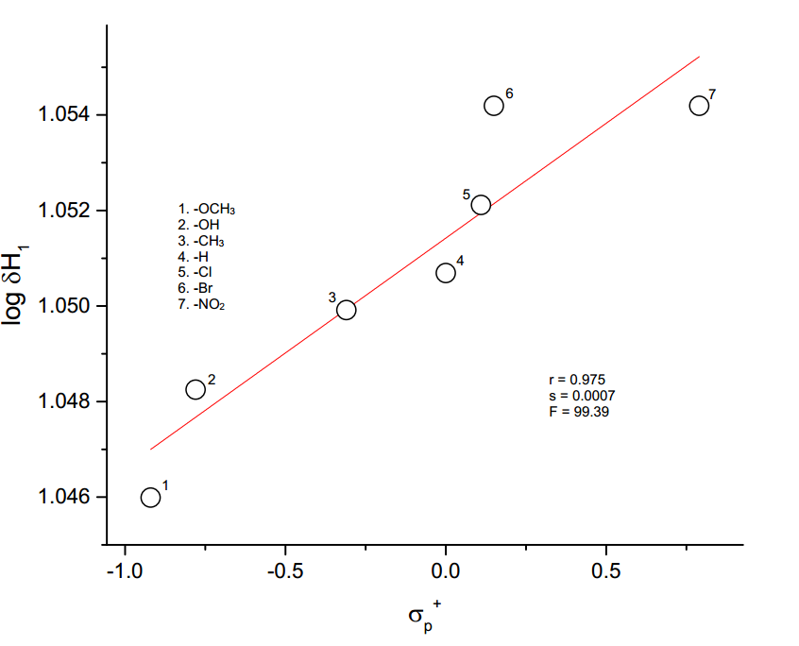
H₁ – Hydrogen atom
The plot of log δH₁ vs σ_{p}⁺
SSP analysis
log δH₁ = 0.004 σ_{p}⁺ + 1.05
(±0.001)
r = 0.975; s = 0.001; F = 27.35; n =6
DSP analysis
log δH₁ = 0.004 F + 0.008 R + 1.051
(±0.002) (±0.001) (±0.001)
R = 0.966; SE = 0.001; F = 27.96; n = 7

Slide 66
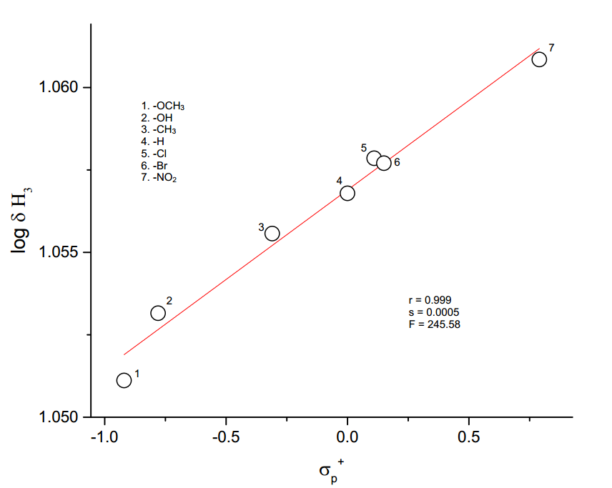
H₃ – Hydrogen atom
The plot of log δH₃ vs σ_{p}⁺
SSP analysis
log δH₃ = 0.005 σ_{p}⁺ + 1.056
(±0.001) (±0.001)
r = 0.999; s = 0.0005; F = 245.58; n = 7
DSP analysis
log δH₃ = 0.005 F + 0.010 R + 1.057
(±0.001) (±0.001) (0.001)
R = 0.984; SE = 0.001; F = 63.96; n = 7

Slide 67
H₇ – Hydrogen atom
The SSP analysis
log δH₇ = 0.002 σ_{p}⁺/ σ_{p}⁻ + 0.916 (±0.001) (±0.001)
r = 0.746; s = 0.001; F = 6.29; n = 7
DSP analysis
log δH₇ = 0.001 σ_{I} + 0.006 σ_{R}º + 0.917 (±0.001) (±0.001) (±0.001)
R = 0.923; SE = 0.001; F = 2.05; n = 6

Slide 68
TSP analysis of SCS data of H_{3′5′} hydrogen atom of substituted
5-benzylidenebarbituric acids
S.No. | Scale | α | β | φ | r | s | n
1. | σ_{I}, σ_{R}º,ν | 0.037 (±0.051) | 0.032 (±0.030) | 0.152 (±0.032) | 0.866 | 0.017 | 6
2. | σ_{I}, σ_{R}⁺, ν | -0.035 (±0.008) | 0.029 (±0.002) | 0.043 (±0.004) | 0.996 | 0.029 | 6
3. | F, R, ν | 0.041 (±0.012) | 0.070 (±0.007) | 0.006 (±0.001) | 0.994 | 0.004 | 7

Slide 69
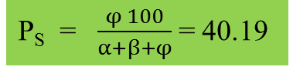
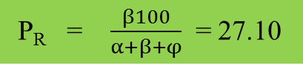
H_{3′5′} – Hydrogen atom
SSP analysis
DSP analysis
log δH_{3′5′} = 0.052 σ_{o}* + 0.865
(±0.007) (±0.003)
r = 0.966; s = 0.007; F = 56.20; n = 6
log δH_{3′5′} = 0.049F + 0.073R + 0.874
(±0.006) (±0.005) (±0.003)
R = 0.992; SE = 0.04; F = 132.74; n = 7
TSP analysis
log δH_{3′5′} = -0.035 σ_{I} + 0.029 σ_{R}⁺ + 0.045 ν + 0.875
(±0.019) (±0.038) (±0.061) (±0.003)
R = 0.998; s = 0.039; n = 6
P_{R} = $\frac{β100}{α+β+φ}$ = 27.10
P_{S} = $\frac{φ 100}{α+β+φ}$ = 40.19

Slide 70
Correlations with Lynch-Equation
Results of Lynch correlations of ¹³C chemical shifts of compound 4’-subsutited 5-benzylidenebarbituric acid with SCS values for mono substituted benzenes.
S.No. | Carbons | Benzene SCS (S) | Slope | Intercept | r | n | s
1. | C_{4′} | S_{i} | 0.97 | 132.23 | 0.988 | 6 | 2.17
2. | C_{3′5′} | S_{O} | 0.84 | 129.73 | 0.828 | 6 | 4.14
3. | C_{2′6′} | S_{m} | 0.71 | 132.69 | 0.113 | 6 | 5.63
4. | C_{1’} | S_{p} | 0.94 | -126.43 | 0.993 | 6 | 0.61

Slide 71
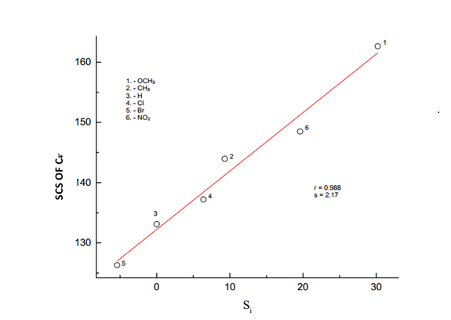
Lynch plot of SCS of C_{4′} vs S_{i}
SCS of C_{4’} = 0.97S_{i} +132.23
r =0.988 ; n=8 : S=2.17
slope is 0.97, which reveals that the fixed substituent
Y=-CH-C-C₃H₂N₂O₃, has little effect on the additivity of this shifts.

Slide 72
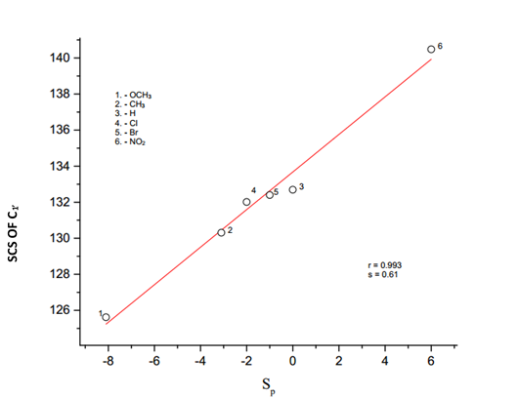
Lynch plot of SCS of C_{1′} vs S_{p}
SCS of C_{1’} = 0.94 S_{i} -126.43
r= 0.993 ; n=6 ; S=0.61
The slope value b=0.94 demonstrates that the fixed substituent Y has little effect on the additivity of these shifts.

Slide 73
¹³C NMR chemical shifts(ppm) of 4′-substituted 5-benzylidenebarbituric acids
S.No. | p-X | C_{1′} | C_{3′5′} | C₄ | C₅ | C₆ | C₇
1 | -OCH₃ | 125.62 | 114.41 | 164.39 | 116.00 | 163.92 | 155.46
2 | -OH | 124.24 | 115.97 | 164.59 | 114.61 | 162.75 | 156.05
3 | -CH₃ | 130.31 | 129.33 | 164.08 | 118.3 | 162.26 | 155.46
4 | -H | 132.69 | 128.52 | 163.87 | 119.55 | 162.03 | 155.2
5 | -Cl | 132.01 | 128.55 | 163.67 | 120.09 | 162.04 | 153.52
6 | -Br | 132.4 | 131.51 | 163.67 | 120.24 | 162.04 | 153.56
7 | -NO₂ | 140.48 | 132.69 | 163.13 | 123.15 | 161.62 | 151.63

Slide 74
Results of statistical treatment of ¹³C – Chemical shift with σ_{p,} σ_{p}º, σ_{p}⁺, σ_{p}⁺/ σ_{p,} σ_{p}⁺/ σ_{p}⁻,σ_{p}⁺/ σ_{p/} σ_{p}⁻substituent constants using single parameter equation
S.No. | Carbons | Scale | ρ | r | s | F | log δº | n
1 | C_{1′} | σ_{p} | 0.043±0.006 | 0.949 | 0.006 | 43.33 | 2.115±0.002 | 7
 |  | σ_{p}^{O} | 0.038±0.010 | 0.882 | 0.008 | 13.99 | 2.114±0.004 | 6
 |  | σ_{p}⁺ | 0.029±0.002 | 0.986 | 0.003 | 179.37 | 2.121±0.001 | 7
 |  | σ_{p}⁺/ σ_{p} | 0.033±0.006 | 0.924 | 0.007 | 29.11 | 2.117±0.003 | 7
 |  | σ_{p}⁺/ σ_{p}⁻ | 0.024±0.002 | 0.989 | 0.003 | 226.34 | 2.118±0.001 | 7
 |  | σ_{p}⁺/ σ_{p/} σ_{p}⁻ | 0.026±0.004 | 0.938 | 0.006 | 37.12 | 2.115±0.002 | 7
2 | C₄ | σ_{p} | -0.003±0.001 | 0.979 | 0.0003 | 116.72 | 2.240±0.001 | 7
 |  | σ_{p}^{O} | -0.003±0.001 | 0.945 | 0.0004 | 33.30 | 2.215±0.001 | 6
 |  | σ_{p}⁺ | -0.002±0.001 | 0.996 | 0.0001 | 640.41 | 2.214±0.001 | 7
 |  | σ_{p}⁺/ σ_{p} | -0.002±0.001 | 0.935 | 0.0005 | 34.80 | 2.214±0.001 | 7
 |  | σ_{p}⁺/ σ_{p}⁻ | -0.002±0.001 | 0.983 | 0.0003 | 145.26 | 2.214±.0001 | 7
 |  | σ_{p}⁺/ σ_{p/} σ_{p}⁻ | -0.002±0.001 | 0.930 | 0.0005 | 32.23 | 2.215±0.001 | 7

Slide 75
S.No. | Carbons | Scale | ρ | r | s | F | log δº | n
3 | C₅ | σ_{p} | 0.025±0.004 | 0.950 | 0.004 | 45.95 | 2.073±0.001 | 7
 |  | σ_{p}^{O} | 0.021±0.005 | 0.900 | 0.004 | 17.16 | 2.073±0.002 | 6
 |  | σ_{p}⁺ | 0.018±0.001 | 0.995 | 0.001 | 508.52 | 2.077±0.001 | 7
 |  | σ_{p}⁺/ σ_{p} | 0.019±0.003 | 0.917 | 0.005 | 26.46 | 2.075±0.002 | 7
 |  | σ_{p}⁺/ σ_{p}⁻ | 0.014±0.002 | 0.970 | 0.003 | 80.18 | 2.075±0.001 | 7
 |  | σ_{p}⁺/ σ_{p/} σ_{p}⁻ | 0.015±0.003 | 0.902 | 0.005 | 21.75 | 2.075±0.002 | 7
4 | C₆ | σ_{p} | -0.004±0.002 | 0.722 | 0.001 | 5.43 | 2.211±0.001 | 7
 |  | σ_{p}^{O} | -0.004±0.002 | 0.620 | 0.002 | 2.51 | 2.211±0.001 | 6
 |  | σ_{p}⁺ | -0.003±0.001 | 0.820 | 0.001 | 10.24 | 2.210±0.001 | 7
 |  | σ_{p}⁺/ σ_{p} | -0.004±0.001 | 0.917 | 0.001 | 26.41 | 2.210±0.001 | 7
 |  | σ_{p}⁺/ σ_{p}⁻ | -0.002±0.001 | 0.775 | 0.001 | 7.51 | 2.210±0.001 | 7
 |  | σ_{p}⁺/ σ_{p/} σ_{p}⁻ | -0.003±0.001 | 0.836 | 0.001 | 11.63 | 2.210±0.001 | 7

Slide 76
S.No. | Carbons | Scale | ρ | r | s | F | log δº | n
5 | C₇ | σ_{p} | -0.011±0.001 | 0.984 | 0.001 | 152.18 | 2.189±0.001 | 7
 |  | σ_{p}^{O} | -0.015±0.001 | 0.988 | 0.001 | 163.39 | 2.190±0.001 | 6
 |  | σ_{p}⁺ | -0.007±0.001 | 0.916 | 0.002 | 25.94 | 2.187±0.001 | 7
 |  | σ_{p}⁺/ σ_{p} | -0.008±0.002 | 0.887 | 0.002 | 18.40 | 2.188±0.001 | 7
 |  | σ_{p}⁺/ σ_{p}⁻ | -0.006±0.001 | 0.938 | 0.002 | 36.47 | 2.188±0.001 | 7
 |  | σ_{p}⁺/ σ_{p/} σ_{p}⁻ | -0.006±0.001 | 0.917 | 0.002 | 26.68 | 2.189±0.001 | 7
6 | C_{3′5′} | σ_{o} | 0.044±0.024 | 0.632 | 0.02 | 3.33 | 2.094±0.008 | 7
 |  | σ_{o}* | 0.038±0.020 | 0.691 | 0.02 | 3.66 | 2.095±0.009 | 6
 |  | E_{s} | -0.042±0.013 | 0.825 | 0.016 | 10.69 | 2.103±0.006 | 7
“n=6 means calculated without -OH group”

Slide 77
DSP analysis of chemical shift data with dual parameter equation
S.No | Carbons | Scale | ρ_{I} | ρ_{R} | R | SE | F | log δº | n | λ=ρ_{R/}ρ_{I}
1 | C_{1′} | σ_{I ,}σ_{R} | 0.024±0.003 | 0.051±0.003 | 0.995 | 0.002 | 154.44 | 2.122±0.001 | 6 | 0.25
 |  | σ_{I ,}σ_{R}º | 0.032±0.017 | 0.036±0.017 | 0.849 | 0.01 | 3.89 | 2.118±0.007 | 6 | 1.33
 |  | σ_{I ,}σ_{R}⁺ | 0.010±0.030 | 0.018±0.016 | 0.640 | 0.016 | 1.39 | 2.122±0.015 | 7 | 1.80
 |  | σ_{I ,}σ_{R}⁻ | 0.019±0.011 | 0.037±0.009 | 0.943 | 0.007 | 12.10 | 2.120±0.005 | 6 | 2.00
 |  | F,R | 0.025±0.003 | 0.054±0.002 | 0.996 | 0.002 | 279.61 | 2.123±0.001 | 7 | 2.00
2 | C₄ | σ_{I ,}σ_{R} | -0.003±0.001 | -0.003±0.001 | 0.998 | 0.0001 | 341.86 | 2.214±0.001 | 6 | 1.50
 |  | σ_{I ,}σ_{R}º | -0.003±0.001 | -0.002±0.001 | 0.859 | 0.0007 | 4.22 | 2.214±0.001 | 6 | 0.66
 |  | F,R | -0.002±0.001 | -0.004±0.001 | 0.993 | 0.002 | 152.18 | 2.214±0.001 | 7 | 2.00
3 | C₅ | σ_{I ,}σ_{R} | 0.016±0.002 | 0.026±0.002 | 0.996 | 0.001 | 176.46 | 2.077±0.001 | 6 | 1.63
 |  | σ_{I ,}σ_{R}º | 0.019±0.010 | 0.016±0.010 | 0.810 | 0.006 | 2.86 | 2.074±0.004 | 6 | 0.80
 |  | σ_{I ,}σ_{R}⁺ | 0.008±0.019 | 0.010±0.009 | 0.636 | 0.01 | 1.36 | 2.076±0.009 | 7 | 1.25
 |  | σ_{I ,}σ_{R}⁻ | 0.014±0.008 | 0.017±0.007 | 0.885 | 0.005 | 5.43 | 2.075±0.003 | 6 | 1.21
 |  | F,R | 0.015±0.003 | 0.032±0.002 | 0.990 | 0.002 | 105.40 | 2.078±0.001 | 7 | 2.13

Slide 78
S.No | Carbons | Scale | ρ_{I} | ρ_{R} | R | SE | F | log δº | n | λ=ρ_{R/}ρ_{I}
4 | C₆ | σ_{I ,}σ_{R} | -0.001±0.001 | -0.008±0.002 | 0.928 | 0.001 | 9.34 | 2.209±0.001 | 6 | 2.00
 |  | σ_{I ,}σ_{R}º | -0.002±0.003 | -0.004±0.003 | 0.550 | 0.002 | 0.649 | 2.210±0.002 | 6 | 2.00
 |  | σ_{I ,}σ_{R}⁺ | 0.001±0.002 | -0.003±0.002 | 0.669 | 0.002 | 1.618 | 2.208±0.002 | 7 | 0.21
 |  | σ_{I ,}σ_{R}⁻ | -0.001±0.001 | -0.004±0.003 | 0.648 | 0.002 | 1.087 | 2.210±0.001 | 6 | 4.00
 |  | F,R | -0.001±0.002 | -0.005±0.002 | 0.806 | 0.001 | 3.719 | 2.209±0.001 | 7 | 5.00
5 | C₇ | σ_{I ,}σ_{R} | -0.013±0.001 | -0.007±0.001 | 0.998 | 0.0003 | 349.25 | 2.191±0.001 | 6 | 0.70
 |  | σ_{I ,}σ_{R}º | -0.014±0.003 | -0.005±0.002 | 0.956 | 0.002 | 16.09 | 2.191±0.001 | 6 | 0.36
 |  | σ_{I ,}σ_{R}⁺ | -0.011±0.006 | -0.002±0.001 | 0.838 | 0.003 | 4.74 | 2.191±0.003 | 7 | 0.20
 |  | σ_{I ,}σ_{R}⁻ | -0.012±0.002 | -0.005±0.001 | 0.980 | 0.001 | 36.20 | 2.191±0.001 | 6 | 0.42
 |  | F,R | -0.014±0.001 | -0.009±0.001 | 0.993 | 0.001 | 146.55 | 2.191±0.001 | 7 | 0.71
6 | C_{3′5′} | σ_{I ,}σ_{R} | 0.010±0.022 | 0.079±0.020 | 0.891 | 0.01 | 5.81 | 2.115±0.010 | 6 | 8.00
 |  | σ_{I ,}σ_{R}º | 0.020±0.001 | 0.031±0.042 | 0.438 | 0.03 | 0.35 | 2.104±0.018 | 6 | 1.50
 |  | F,R | 0.006±0.019 | 0.081±0.024 | 0.903 | 0.01 | 8.85 | 2.117±0.010 | 7 | 1.33
“n=6 means calculated without -OH group”

Slide 79
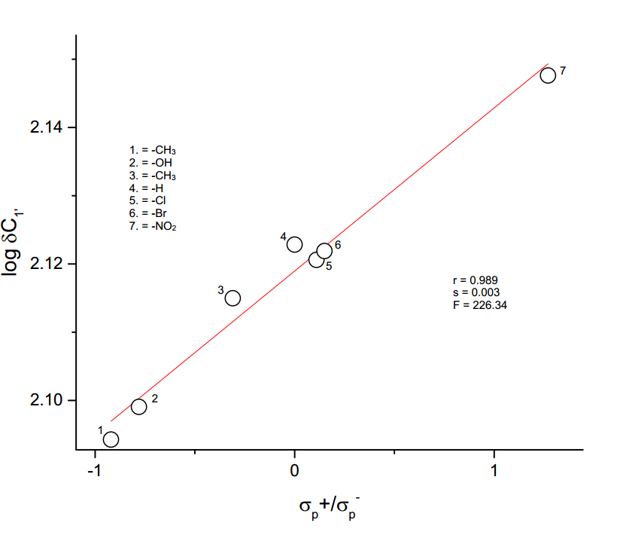
C_{1′} - Carbon atom
The plot of log δC_{1′} vs σ_{p}⁺ / σ_{p}⁻
SSP analysis
log δC_{1′} = 0.024 σ_{p}⁺ / σ_{p}⁻ + 2.118
(±0.002) (±0.001)
r = 0.989; s = 0.003; n = 7
log δC_{1′} = 0.024σ_{I} + 0.051σ_{R} + 2.122
(±0.003) (±0.003) (±0. 001)
R = 0.995; SE = 0.002; n = 6: F = 154.44
log δ C_{1′} = 0.025 F + 0.054 R + 2.123
(±0.003) (±0.002) (±0.001
R = 0.996; SE = 0.002; n = 7; F = 279.61
DSP analysis
Yukawa-Tsuno
equation
log δC_{1′} = 0.028 σ_{p} + 0.032 (σ_{p}⁺- σ_{p}) + 2.12
(±0.006) (±0.009) (±0.002)
R = 0.986; SE = 0.003; n = 7; F = 72.76

Slide 80
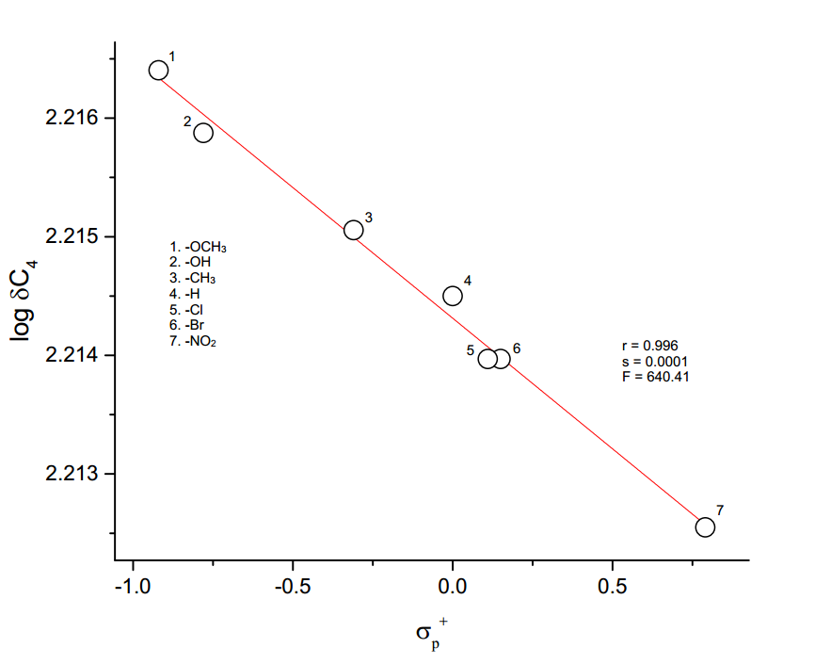
C₄ – Carbon atom
The plot of log δ C₄ vs σ_{p}⁺
SSP analysis
log δC₄ = -0.002σ_{p}⁺ + 2.214
(±0.001) (±0.001)
r=0.996; s=0.0001; F=640.41; n=7
DSP analysis
log δC₄ = -0.003σ_{I} - 0.003 σ_{R} + 2.214
(±0.001) (±0.001) (±0.001)
R = 0.998; SE = 0.0001; F = 341.86; n =6
log δ C₄ = -0.002F - 0.004 R + 2.214
(±0.001) (±0.001) (±0.001)
R = 0.993; SE = 0.002; F = 152.18; n = 7
Yukawa-Tsuno equation
log δC₄ = -0.003 σ_{p} - 0.002 (σ_{p}⁺- σ_{p}) + 2.214
(±0.001) (±0.001) (±0.001)
R = 0.998; SE = 0.002; F = 152.18; n = 7

Slide 81
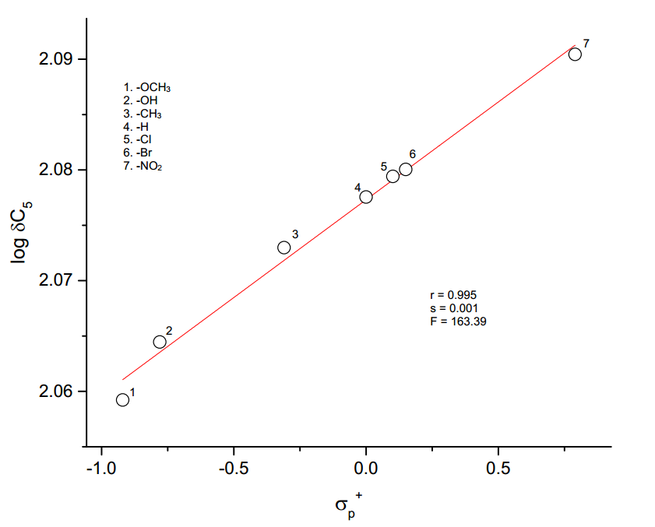
C₅ – Carbon atom
The plot of log δC₅ vs σ_{p}⁺
SSP analysis
log δ C₅ = 0.018 σ_{p}⁺ + 2.077
(±0.001) (±0.001)
r = 0.995; s = 0.001; n = 7; F =508.52
DSP analysis
log δ C₅ = 0.016 σ_{I} + 0.026 σ_{R} + 2.077
(±0.002) (±0.002) (0.001)
R = 0.996; SE = 0.001; F = 176.46; n =6
log δ C₅ = 0.015F + 0.032 R + 2.078
(±0.003) (±0.002) (0.001)
R = 0.990; SE = 0.002; F = 105.40; n =7
Yukawa-Tsuno equation
log δC₅ = 0.016σ_{p} + 0.021 (σ_{p}⁺- σ_{p})+ 2.078
(±0.002) (±0.003) (±0.001)
R = 0.996; SE = 0.001; F = 274.61; n =7

Slide 82
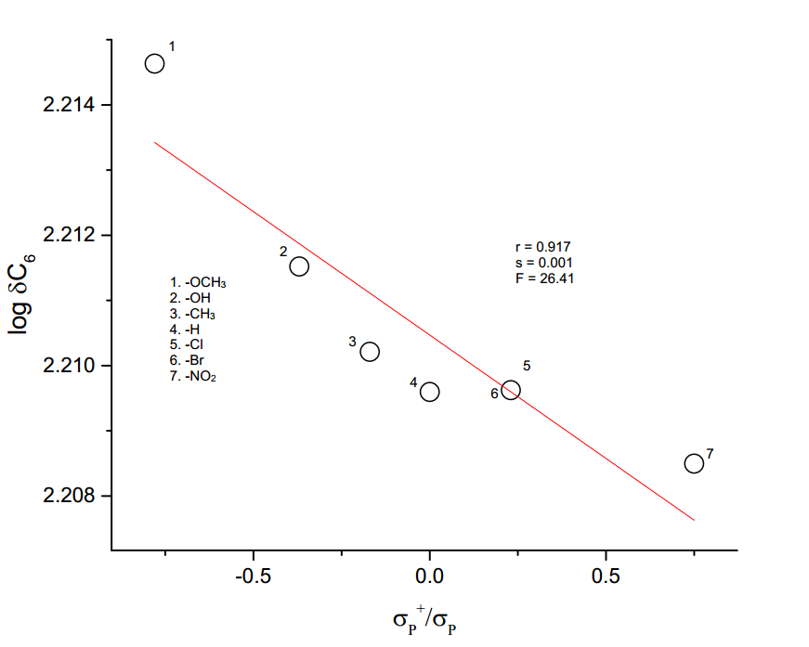
C₆– Carbon atom
The plot of log δC₆ vs σ_{p}⁺/σ_{p}
SSP analysis
log δC₆ = -0.004σ_{p}⁺/σ_{p} + 2.210
(±0.001) (±0.003)
r = 0.917; s = 0.001; F = 26.41; n = 7
DSP analysis
log δC₆ = -0.001σ_{I} - 0.008 σ_{R} + 2.209
(±0.001 (±0.002) (±0.001)
R = 0.928; SE = 0.001; F = 9.34; n = 6
Yukawa-Tsuno equation
log δC₆ = -0.001σ_{p}º - 0.005(σ_{p}⁺/ σ_{p}º ) + 2.208
(±0.001) (±0.001) (±0.001)
R = 0.937; SE = 0.001; F = 10.76; n = 6

Slide 83
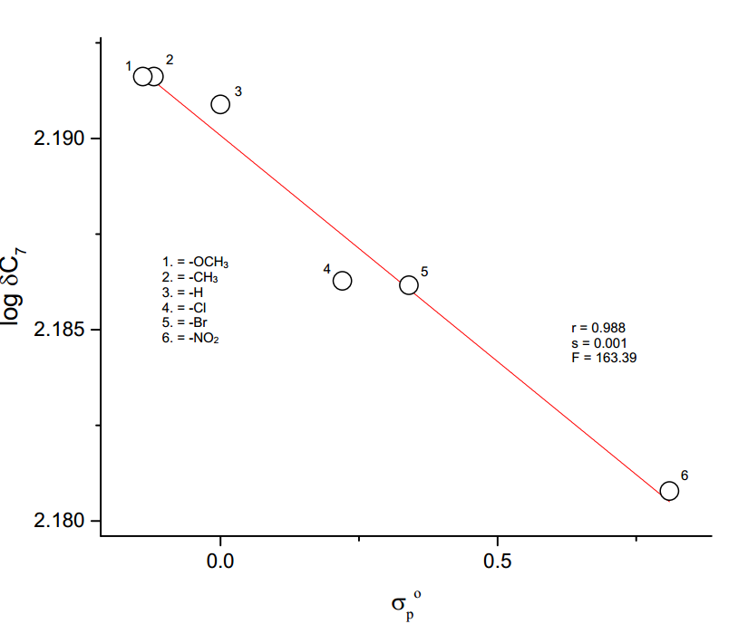
C₇- Carbon atom
The plot of log δ C₇ vs σ_{p}º
SSP analysis
log δC₇ = -0.015σ_{p}º + 2.190
(±0.001) (±0.001)
r = 0.988; s = 0.001; n = 6
log δC₇ = -0.013σ_{I} - 0.007σ_{R} + 2.191
(±0.001) (±0.001) (0.001)
R = 0.998; SE = 0.0003; n = 6; F = 349.25
log δC₇ = -0.014F - 0.009R + 2.191
(±0.001) (±0.001) (±0.001)
R = 0.993; SE = 0.001; n = 7; F= 146.55
DSP analysis
Yukawa-Tsuno equation
log δC₇ = -0.013 σ_{p} + 0.004 (σ_{p}⁺- σ_{p}) + 2.190
(±0.001) (±0.002) (±0.004)
R = 0.994; SE = 0.001; n = 7; F = 167.30

Slide 84
TSP analysis of SCS data of C_{3′5′} carbon atoms of 4′-substituted 5-benzylidenebarbituric acids
S.No. | Scale | α | β | φ | R | s | F | P_{R} | P_{S}
1. | σ_{I}, σ_{R},ν | 0.019 (±0.045) | 0.084 (±0.034) | -0.007 (±0.029) | 0.895 | 0.016 | 2.68 | 76.4 | 6.40
2. | σ_{I}, σ_{R}º,ν | -0.008 (±0.092) | 0.019 (±0.060) | 0.022 (±0.058) | 0.492 | 0.030 | 6.00 | 39.0 | 43.80
3. | σ_{I}, σ_{R}⁺,ν | -0.093 (±0.071) | 0.035 (±0.023) | 0.057 (±0.035) | 0.760 | 0.155 | 1.37 | 19.2 | 31.30
4. | σ_{I}, σ_{R}-,ν | 0.006 (±0.085) | 0.039 (±0.058) | 0.001 (±0.063) | 0.595 | 0.030 | 0.36 | 84.7 | 2.17
5. | F, R, ν | -0.001 (±0.050) | 0.078 (±0.027) | 0.005 (±0.030) | 0.904 | 0.016 | 7.00 | 92.0 | 5.95

Slide 85
C_{3′5′}-Carbon atoms
SSP analysis
log δC_{3′5′} = 0.044 σ_{o} + 2.094
(±0.024) (±0.008)
r = 0.632; s =0.02; n =7
log δ C_{3′5′} = 0.038 σ_{o}* + 2.095
(±0.020) (±0.009)
r = 0.691; s =0.02; n =6
log δC_{3′5′} = -0.042 E_{s} + 2.103
(±0.013) (±0.006)
r = 0.825; s = 0.016; n =7
TSP analysis
DSP analysis
log δC_{3′5′} = 0.010σ_{I} + 0.079σ_{R} + 2.115
(±0.020) (±0.020) (±0.010)
R = 0.891; SE = 0.01; n = 6
log δC_{3′5′} = 0.006 F + 0.081 R + 2.117
(±0.019) (±0.019) (±0.010)
R = 0.903; SE = 0.01; n = 7
log δC_{3′5′} = 0.019 σ_{I} + 0.084 σ_{R} - 0.007 ν + 2.117
(±0.045) (±0.034) (±0.029) (±0.015)
R = 0.895; SE = 0.016; n = 6
log δC_{3′5′} = -0.001F + 0.078R - 0.005 ν + 2.116
(±0.050) (±0.027) (±0.030) (±0.014)
R = 0.904, s =0.016, n = 7

Slide 86
Conclusions
A series of seven numbers of substituted 5-benzylidenebarbituric acids have been synthesized by condensation of barbituric acid with substituted benzaldehydes. These synthesized substituted 5-benzylidenebarbituric acids have been characterized by the ¹H and¹³C spectral data. The ¹H and ¹³C NMR spectral data of these substituted 5-benzylidenebarbituric acids have been correlated with Hammett substituent constants and F and R parameters. From the results of statistical analysis, the effects of the substituent on the spectral data have been studied. The ¹H and ¹³C NMR spectral correlations produced the most number of satisfactory correlations.

Slide 87

Effect of substituent on the ¹³C - NMR chemical shifts of substituted
5-benzylidenebarbituric acids.
P.Mohandass, K.Radhakrishnan, S.Manimekalai, V.Suriyanarayanan and S.Radhakrishnan. Asian Journal of Research in Chemistry (in press).

Slide 88
CHAPTER 4
Antibacterial activity: A structure-reactivity study

Slide 89
CHAPTER 4
Antibacterial activity of
4′-substituted 2-benzylidene-1,3-indandiones

Slide 90
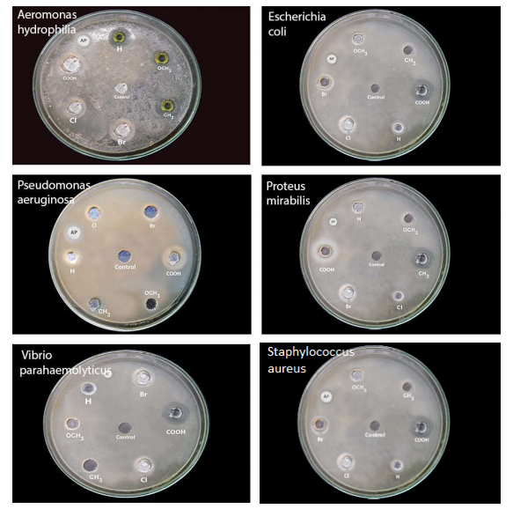
CHAPTER 4
Antibacterial activity of 4′-substituted 2-benzylidene-1,3-indandiones

Slide 91
CHAPTER 4
Antibacterial activity (Zone of inhibition (mm) values) of 4′-substituted 2-benzylidene-1,3-indandiones
S.No. | Name of the microorganisms | Inhibition zone radius (mm)
 |  | Standard (Amphotericin – B) | -OCH₃ | -CH₃ | -H | -Cl | -Br | -COOH
1 | Aeromonas hydrophilia | 21 | 5 | 6 | 7 | 8 | 9 | 12
2 | Escherichia coli | 16 | 6 | 7 | 8 | 9 | 10 | 12
3 | Pseudomonas aeruginosa | 21 | 5 | 6 | 8 | 8 | 9 | 11
4 | Proteus mirabilis | 18 | 5 | 6 | 7 | 9 | 10 | 12
5 | Vibrio parahaemolyticus | 18 | 5 | 7 | 9 | 10 | 10 | 12
6 | Staphylococcus aureus | 16 | 6 | 7 | 8 | 9 | 9 | 11

Slide 92
Results of statistical treatment of log IZR (mm) with σ_{p}, σ_{p}º, σ_{p}⁺, σ_{p}⁺/ σ_{p},
σ_{p}⁺/ σ_{p}⁻, σ_{p}⁺/ σ_{p} / σ_{p}⁻, substituent constants using single parameter equation
S.No. | Bacteria | Scale | ρ | r | s | F | log(IZR)º | n
1 | Aeromonas hydrophila | σ_{p} | 0.48±0.04 | 0.981 | 0.03 | 104.12 | 0.839±0.012 | 6
 |  | σ_{p}º | 0.50±0.11 | 0.915 | 0.06 | 20.56 | 0.815±0.028 | 6
 |  | σ_{p}⁺ | 0.30±0.05 | 0.950 | 0.05 | 37.47 | 0.897±0.019 | 6
 |  | σ_{p}⁺/ σ_{p} | 0.29±0.06 | 0.927 | 0.06 | 24.42 | 0.878±0.023 | 6
 |  | σ_{p}⁺/ σ_{p}⁻ | 0.26±0.03 | 0.981 | 0.03 | 102.65 | 0.879±0.012 | 6
 |  | σ_{p}⁺/ σ_{p} / σ_{p}⁻ | 0.25±0.03 | 0.972 | 0.04 | 67.47 | 0.865±0.015 | 6
2 | Escherichia coli | σ_{p} | 0.39±0.03 | 0.985 | 0.02 | 134.03 | 0.896±0.008 | 6
 |  | σ_{p}º | 0.40±0.09 | 0.918 | 0.05 | 21.50 | 0.877±0.022 | 6
 |  | σ_{p}⁺ | 0.25±0.04 | 0.960 | 0.03 | 47.81 | 0.944±0.014 | 6
 |  | σ_{p}⁺/ σ_{p} | 0.23±0.04 | 0.940 | 0.04 | 30.76 | 0.928±0.017 | 6
 |  | σ_{p}⁺/ σ_{p}⁻ | 0.20±0.02 | 0.975 | 0.03 | 78.24 | 0.929±0.011 | 6
 |  | σ_{p}⁺/ σ_{p} / σ_{p}⁻ | 0.20±0.03 | 0.970 | 0.03 | 64.73 | 0.917±0.012 | 6
3 | Pseudomonas aeruginosa | σ_{p} | 0.45±0.05 | 0.976 | 0.03 | 81.07 | 0.853±0.013 | 6
 |  | σ_{p}º | 0.47±0.10 | 0.916 | 0.06 | 21.05 | 0.830±0.026 | 6
 |  | σ_{p}⁺ | 0.30±0.03 | 0.986 | 0.02 | 140.74 | 0.909±0.010 | 6
 |  | σ_{p}⁺/ σ_{p} | 0.28±0.04 | 0.963 | 0.04 | 52.47 | 0.890±0.015 | 6
 |  | σ_{p}⁺/ σ_{p}⁻ | 0.24±0.03 | 0.968 | 0.04 | 61.35 | 0.891±0.014 | 6
 |  | σ_{p}⁺/ σ_{p} / σ_{p}⁻ | 0.24±0.03 | 0.965 | 0.04 | 54.32 | 0.877±0.015 | 6

Slide 93
S.No | Bacteria | Scale | ρ | r | s | F | log(IZR)º | n
4 | Proteus miratrilis | σ_{p} | 0.52±0.03 | 0.992 | 0.02 | 257.61 | 0.852±0.008 | 6
 |  | σ_{p}º | 0.55±0.10 | 0.943 | 0.05 | 32.39 | 0.824±0.025 | 6
 |  | σ_{p}⁺ | 0.32±0.05 | 0.952 | 0.05 | 38.53 | 0.915±0.020 | 6
 |  | σ_{p}⁺/ σ_{p} | 0.31±0.06 | 0.940 | 0.05 | 38.53 | 0.895±0.022 | 6
 |  | σ_{p}⁺/ σ_{p}⁻ | 0.27±0.04 | 0.953 | 0.05 | 30.39 | 0.895±0.020 | 6
 |  | σ_{p}⁺/ σ_{p} / σ_{p}⁻ | 0.27±0.04 | 0.956 | 0.05 | 40.01 | 0.880±0.019 | 6
5 | Vibrio paraheamolyticus | σ_{p} | 0.47±0.08 | 0.945 | 0.05 | 33.62 | 0.893±0.023 | 6
 |  | σ_{p}º | 0.48±0.14 | 0.865 | 0.08 | 11.91 | 0.870±0.036 | 6
 |  | σ_{p}⁺ | 0.32±0.01 | 0.998 | 0.01 | 1337.04 | 0.952±0.003 | 6
 |  | σ_{p}⁺/ σ_{p} | 0.31±0.02 | 0.990 | 0.02 | 200.93 | 0.932±0.009 | 6
 |  | σ_{p}⁺/ σ_{p}⁻ | 0.26±0.04 | 0.964 | 0.04 | 52.37 | 0.932±0.017 | 6
 |  | σ_{p}⁺/ σ_{p} / σ_{p}⁻ | 0.26±0.03 | 0.973 | 0.03 | 72.13 | 0.917±0.014 | 6
6 | Staphylococcus aureus | σ_{p} | 0.33±0.03 | 0.987 | 0.02 | 162.40 | 0.887±0.007 | 6
 |  | σ_{p}º | 0.35±0.07 | 0.931 | 0.04 | 25.90 | 0.869±0.018 | 6
 |  | σ_{p}⁺ | 0.21±0.02 | 0.979 | 0.02 | 92.15 | 0.927±0.009 | 6
 |  | σ_{p}⁺/ σ_{p} | 0.20±0.03 | 0.962 | 0.03 | 49.60 | 0.914±0.011 | 6
 |  | σ_{p}⁺/ σ_{p}⁻ | 0.18±0.14 | 0.988 | 0.16 | 164.59 | 0.914±0.006 | 6

Slide 94
DSP analysis of log IZR (mm) with dual parameter equation
S. No | Bacteria | Scale | ρ_{I} | ρ_{R} | R | SE | F | log(IZR)º | n | λ=ρ_{R/}ρ_{I}
1 | Aeromonas Hydrophila | σ_{I,} σ_{R} | 0.44±0.17 | 0.50±0.17 | 0.890 | 0.08 | 05.72 | 0.87±0.05 | 6 | 1.14
 |  | σ_{I ,}σ_{R}⁺ | 0.08±0.18 | 0.17±0.06 | 0.876 | 0.08 | 04.97 | 0.92±0.07 | 6 | 2.12
 |  | σ_{I ,}σ_{R}⁻ | 0.61±0.05 | 0.68±0.06 | 0.991 | 0.02 | 84.98 | 0.86±0.02 | 6 | 1.11
 |  | F,R | 0.41±0.08 | 0.46±0.08 | 0.979 | 0.03 | 22.27 | 0.84±0.02 | 5 | 1.12
2 | Escherichia coli | σ_{I ,}σ_{R} | 0.37±0.12 | 0.42±0.12 | 0.918 | 0.06 | 08.04 | 0.92±0.04 | 6 | 1.14
 |  | σ_{I ,}σ_{R}⁺ | 0.08±0.15 | 0.14±0.05 | 0.880 | 0.07 | 05.17 | 0.96±0.05 | 6 | 1.75
 |  | σ_{I ,}σ_{R}⁻ | 0.50±0.06 | 0.53±0.06 | 0.986 | 0.02 | 50.92 | 0.91±0.02 | 6 | 1.06
 |  | F,R | 0.36±0.07 | 0.39±0.07 | 0.978 | 0.03 | 21.88 | 0.90±0.02 | 5 | 1.08
3 | Pseudomonas aeruginosa | σ_{I ,}σ_{R} | 0.43±0.10 | 0.53±0.11 | 0.956 | 0.05 | 16.19 | 0.89±0.03 | 6 | 1.23
 |  | σ_{I ,}σ_{R}⁺ | 0.06±0.14 | 0.17±0.05 | 0.920 | 0.06 | 08.35 | 0.94±0.05 | 6 | 2.83
 |  | σ_{I ,}σ_{R}⁻ | 0.56±0.10 | 0.62±0.11 | 0.966 | 0.04 | 20.96 | 0.87±0.03 | 6 | 1.11
 |  | F,R | 0.43±0.22 | 0.56±0.23 | 0.999 | 0.01 | 341.28 | 0.88±0.01 | 5 | 1.30

Slide 95
S. No | Bacteria | Scale | ρ_{I} | ρ_{R} | R | SE | F | log(IZR)º | n | λ=ρ_{R/}ρ_{I}
4 | Proteus miratrilis | σ_{I ,}σ_{R} | 0.54±0.13 | 0.53±0.14 | 0.944 | 0.06 | 12.26 | 0.87±0.04 | 6 | 0.98
 |  | σ_{I ,}σ_{R}⁺ | 0.18±0.19 | 0.17±0.07 | 0.883 | 0.09 | 05.29 | 0.91±0.07 | 6 | 0.94
 |  | σ_{I ,}σ_{R}⁻ | 0.69±0.09 | 0.66±0.09 | 0.980 | 0.04 | 36.34 | 0.86±0.02 | 6 | 0.96
 |  | F,R | 0.54±0.80 | 0.54±0.08 | 0.984 | 0.03 | 31.31 | 0.85±0.03 | 5 | 1.00
5 | Vibrio paraheamolyticus | σ_{I,} σ_{R} | 0.42±0.08 | 0.61±0.08 | 0.980 | 0.03 | 36.82 | 0.95±0.02 | 6 | 1.45
 |  | σ_{I ,}σ_{R}⁺ | 0.02±0.19 | 0.18±0.07 | 0.865 | 0.09 | 4.45 | 0.99±0.07 | 6 | 9.00
 |  | σ_{I ,}σ_{R}⁻ | 0.55±0.15 | 0.68±0.16 | 0.934 | 0.06 | 10.3 | 0.93±0.05 | 6 | 1.24
 |  | F,R | 0.42±0.03 | 0.66±0.03 | 0.998 | 0.01 | 314.17 | 0.95±0.01 | 5 | 1.57
6 | Staphylococcus aureus | σ_{I,}σ_{R} | 0.31±0.09 | 0.37±0.10 | 0.931 | 0.04 | 9.72 | 0.91±0.03 | 6 | 1.19
 |  | σ_{I ,}σ_{R}⁺ | 0.05±0.12 | 0.12±0.04 | 0.889 | 0.05 | 5.65 | 0.95±0.04 | 6 | 2.40
 |  | σ_{I ,}σ_{R}⁻ | 0.41±0.05 | 0.47±0.05 | 0.985 | 0.02 | 47.30 | 0.90±0.01 | 6 | 1.15
 |  | F,R | 0.29±0.19 | 0.36±0.19 | 0.998 | 0.01 | 216.31 | 0.90±0.01 | 5 | 1.24

Slide 96
Results of multiple regression analysis of log IZR (mm) with σ_{p}, (σ_{p}⁺- σ_{p}) and
σ_{p}º, (σ_{p}⁺- σ_{p}º) constants using Yukawa – Tsuno equation
S.No. | Bacteria | Scale | ρ | r | R | SE | F | n
1 | Aeromonas hydrophila | σ_{p},( σ_{p}⁺- σ_{p}) | 0.45±0.07 | 0.07±0.01 | 0.984 | 0.03 | 45.17 | 6
 |  | σ_{p}º,( σ_{p}⁺- σ_{p}º) | 0.41±0.09 | 0.20±0.90 | 0.970 | 0.04 | 23.99 | 6
2 | Escherichia coli | σ_{p},( σ_{p}⁺- σ_{p}) | 0.35±0.04 | 0.07±0.04 | 0.992 | 0.02 | 94.85 | 6
 |  | σ_{p}º,( σ_{p}⁺- σ_{p}º) | 0.33±0.06 | 0.17±0.06 | 0.978 | 0.03 | 32.96 | 6
3 | Pseudomonas aeruginosa | σ_{p},( σ_{p}⁺- σ_{p}) | 0.38±0.04 | 0.12±0.05 | 0.993 | 0.02 | 110.24 | 6
 |  | σ_{p}º,( σ_{p}⁺- σ_{p}º) | 0.37±0.03 | 0.23±0.03 | 0.996 | 0.02 | 173.63 | 6
4 | Proteus miratrilis | σ_{p},( σ_{p}⁺- σ_{p}) | 0.50±0.04 | 0.04±0.04 | 0.994 | 0.02 | 122.79 | 6
 |  | σ_{p}º,( σ_{p}⁺- σ_{p}º) | 0.46±0.07 | 0.18±0.07 | 0.983 | 0.03 | 44.05 | 6
5 | Vibrio paraheamolyticus | σ_{p},( σ_{p}⁺- σ_{p}) | 0.34±0.04 | 0.22±0.05 | 0.993 | 0.02 | 115.03 | 6
 |  | σ_{p}º,( σ_{p}⁺- σ_{p}º) | 0.33±0.02 | 0.31±0.02 | 0.998 | 0.01 | 556.9 | 6
6 | Staphylococcus aureus | σ_{p},( σ_{p}⁺- σ_{p}) | 0.29±0.02 | 0.07±0.02 | 0.998 | 0.01 | 311.31 | 6
 |  | σ_{p}º,( σ_{p}⁺- σ_{p}º) | 0.28±0.02 | 0.15±0.02 | 0.995 | 0.01 | 145.43 | 6

Slide 97
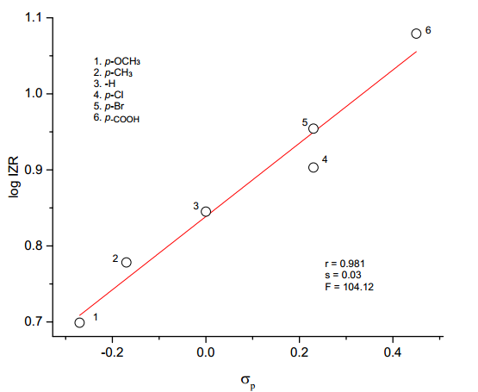
CHAPTER 4
Aeromonas hydrophila
Hammett plot of log IZR vs σ_{p}
SSP analysis
log IZR = 0.48 σ_{p} + 0.839
(±0.04) (±0.012)
r = 0.981, n = 6, F = 104.12
DSP analysis
log IZR = 0.61 σ_{I} + 0.68 σ_{R} + 0.86
(±0.05) (±0.06) (±0.02)
R = 0.991, SE = 0.02, n = 6, F = 84.98
log IZR = 0.41 F + 0.46 R + 0.84
(±0.08) (±0.08) (±0.02)
R = 0.979, SE = 0.03, n = 5, F = 22.27
Yukawa-Tsuno equation
log IZR = 0.45 σ_{p} + 0.07 (σ_{p}⁺- σ_{p}) + 0.85
(±0.07) (±0.01) (±0.02)
R = 0.984, SE = 0.03, n = 6, F = 45.17

Slide 98
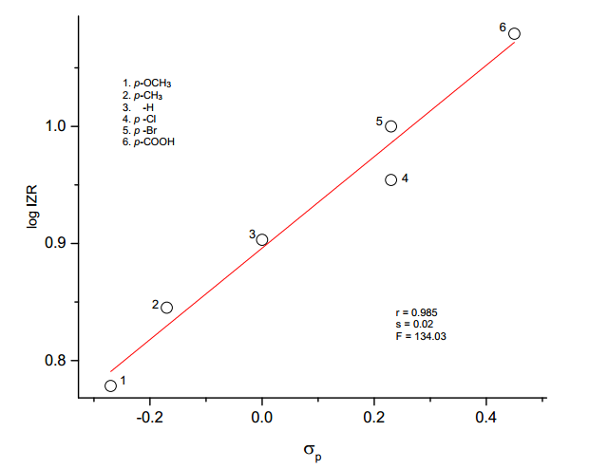
Escherichia coli
Hammett plot of log IZR vs σ_{p}
SSP analysis
log IZR = 0.39 σ_{p} + 0.896
(±0.03) (±0.008)
r = 0.985, s = 0.02, n = 6, F = 134.03
log IZR = 0.50 σ_{I} + 0.53 σ_{R} + 0.92
(±0.06) (±0.06) (±0.02)
R = 0.986, SE = 0.02, n = 6, F = 50.92
log IZR = 0.36 F + 0.39 R + 0.90
(±0.07) (±0.07) (±0.02)
R = 0.978, SE = 0.03, n = 5, F = 21.88
DSP analysis
Yukawa-Tsuno
equation
log IZR = 0.35 σ_{p} + 0.07 (σ_{p}⁺- σ_{p}) + 0.91
(±0.04) (±0.04) (±0.01)
R = 0.992, SE = 0.02, n = 6, F = 94.85

Slide 99
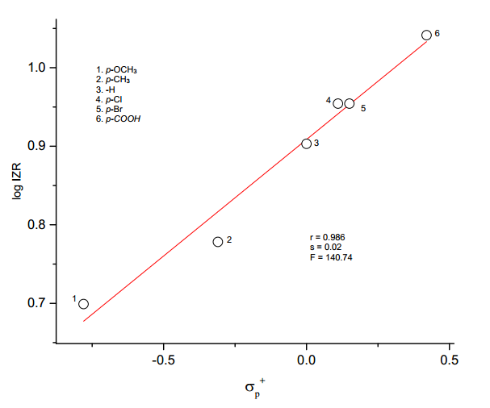
CHAPTER 4
Pseudomonas aeruginosa
Hammett plot of log IZR vs σ_{p}⁺
log IZR = 0.30 σ_{p}⁺ + 0.909
(±0.03) (±0.01)
r = 0.986, s = 0.02, n = 6, F = 140.74
SSP analysis
DSP analysis
log IZR = 0.56 σ_{I} + 0.62 σ_{R}⁻ + 0.87
(±0.10) (±0.11) (±0.03)
R = 0.966, SE = 0.04, n = 6, F = 20.96
log IZR = 0.43 F + 0.56 R + 0.88
(±0.22) (±0.23) (±0.007)
R = 0.999,SE = 0.009, n = 5, F = 341.28
Yukawa-Tsuno
equation
log IZR = 0.37 σ_{p}º + 0.23 (σ_{p}⁺- σ_{p}º) + 0.87
(±0.03) (±0.03) (±0.01)
R = 0.996, SE = 0.02, n = 6, F = 173.63

Slide 100
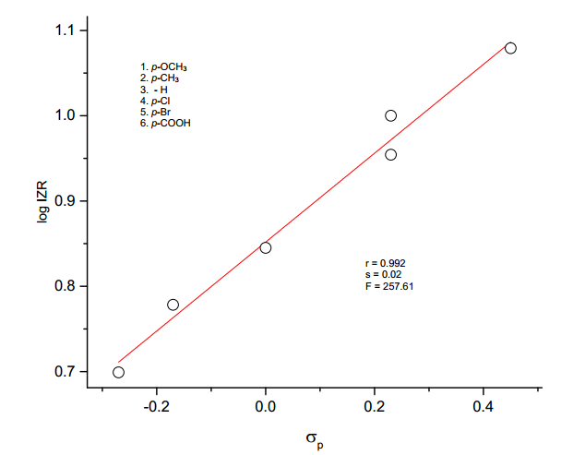
CHAPTER 4
Proteus miratrilis
Hammett plot of log IZR vs σ_{p}
SSP analysis
log IZR = 0.52 σ_{p} + 0.852
(±0.03) (±0.008)
r = 0.992, s = 0.02, n = 6, F = 257.61
DSP analysis
log IZR = 0.69 σ_{I} + 0.66 σ_{R} + 0.86
(±0.09) (±0.09) (±0.02)
R = 0.980, SE= 0.04, n = 6, F = 36.34
log IZR = 0.54 F + 0.54 R + 0.85
(±0.80) (±0.08) (±0.03)
R = 0.984, SE= 0.03, n = 5, F = 31.31
Yukawa-Tsuno equation
log IZR = 0.50 σ_{p} + 0.04 (σ_{p}⁺ - σ_{p)} + 0.86
(±0.04) (±0.04) (±0.01)
R = 0.994, SE = 0.02, n = 6, F = 122.79

Slide 101

CHAPTER 4
Vibrio paraheamolyticus
Hammett plot of log IZR vs σ_{p}⁺
SSP analysis
log IZR = 0.32 σ_{p}⁺ + 0.952
(±0.01) (±0.003)
r = 0.998, s = 0.01, n = 6, F = 1337.04
DSP analysis
log IZR = 0.42 σ_{I} + 0.61 σ_{R} + 0.95
(±0.08) (±0.08) (±0.02)
R = 0.980, SE= 0.03, n = 6, F = 36.82
log IZR = 0.42 F + 0.66 R + 0.95
(±0.03) (±0.03) (±0.008)
R = 0.998, SE= 0.01, n = 5, F = 314.17
Yukawa-Tsuno equation
log IZR = 0.34 σ_{p} + 0.22 (σ_{p}⁺ - σ_{p)} + 0.95
(±0.04) (±0.05) (±0.01)
R = 0.993, SE = 0.02, n = 6, F = 115.0

Slide 102

CHAPTER 4
Staphylococcus aureus
SSP analysis
log IZR = 0.18 σ_{p}⁺/σ_{p}⁻ + 0.914
(±0.14) (±0.006)
r = 0.988, s = 0.16, n = 6, F = 164.59
Hammett plot of log IZR vs σ_{p}⁺/ σ_{p}⁻
DSP analysis
log IZR = 0.41 σ_{I} + 0.47 σ_{R}⁻ + 0.90
(±0.05) (±0.05) (±0.01)
R = 0.985, SE= 0.02, n = 6, F = 47.30
log IZR = 0.29 F + 0.36 R + 0.90
(±0.19) (±0.19) (±0.006)
R = 0.998, SE= 0.007, n = 5, F = 216.31
Yukawa-Tsuno equation
log IZR = 0.29 σ_{p} + 0.07 (σ_{p}⁺ - σ_{p)} + 0.90
(±0.02) (±0.02) (±0.06)
R = 0.998, SE = 0.008, n = 6, F = 311.31

Slide 103

CHAPTER 4

Slide 104
CHAPTER 4
Antibacterial activity of 4′- substituted 5-benzylidenebarbituric acids:
A structure-reactivity study.

Slide 105

CHAPTER 4
Antibacterial activity of 4′-substituted 5-benzylidenebarbituric acids

Slide 106
CHAPTER 4
Antibacterial activity (zone of inhibition(mm) values) of 4′-substituted
5-benzylidenebarbituric acids
S.No. | Name of the microorganism | Inhibition zone diameter (mm)
 |  | Standard (Amphotericin-B) | -OCH₃ | -OH | -CH₃ | -H | -Cl | -Br | -NO₂
1 | Escherichia coli | 21 | 9 | 10 | 12 | 14 | 16 | 17 | 20
2 | Klebsiella oxytoca | 16 | 8 | 12 | 14 | 16 | 20 | 21 | 28
3 | Proteus mirabilis | 18 | 7 | 9 | 10 | 11 | 16 | 19 | 22
4 | Pseudomonas aeruginosa | 21 | 11 | 13 | 15 | 16 | 20 | 23 | 28
5 | Shigella Sonnei | 16 | 8 | 10 | 11 | 12 | 14 | 18 | 21
6 | Staphylococcus aureus | 18 | 7 | 12 | 13 | 14 | 16 | 23 | 28

Slide 107
Results of statistical treatment of log IZD (mm)with σ_{p,}σ_{p}º,σ_{p}⁺,σ_{p}⁺/ σ_{p,} σ_{p}⁺/ σ_{p}⁻,σ_{p}⁺/ σ_{p/} σ_{p}⁻ substituent constants using single parameter equation
S.No. | Bacteria | Scale | ρ | r | s | F | Log(IZD)º | n
1 | Escherichia coli | σ_{P} | 0.31±0.05 | 0.937 | 0.05 | 36.19 | 1.113±0.02 | 7
 |  | σ_{P}º | 0.29±0.09 | 0.854 | 0.07 | 10.78 | 1.100±0.03 | 6
 |  | σ_{P}⁺ | 0.21±0.02 | 0.969 | 0.03 | 76.36 | 1.159±0.01 | 7
 |  | σ_{P}⁺/ σ_{P} | 0.25±0.02 | 0.977 | 0.03 | 104.92 | 1.135±0.01 | 7
 |  | σ_{P}⁺/ σ_{P}⁻ | 0.16±0.03 | 0.934 | 0.05 | 35.95 | 1.140±0.02 | 7
 |  | σ_{P}⁺/ σ_{P/} σ_{P}⁻ | 0.18±0.03 | 0.929 | 0.05 | 31.38 | 1.120±0.02 | 7
2 | Klebsiella oxytoca | σ_{P} | 0.42±0.09 | 0.990 | 0.08 | 21.23 | 1.18±0.03 | 7
 |  | σ_{P}º | 0.43±0.14 | 0.837 | 0.11 | 9.33 | 1.14±0.05 | 6
 |  | σ_{P}⁺ | 0.28±0.05 | 0.926 | 0.07 | 29.94 | 1.23±0.03 | 7
 |  | σ_{P}⁺/ σ_{P} | 0.36±0.02 | 0.993 | 0.02 | 360.60 | 1.20±0.01 | 7
 |  | σ_{P}⁺/ σ_{P}⁻ | 0.22±0.04 | 0.901 | 0.08 | 21.81 | 1.22±0.03 | 7

Slide 108
S.No. | Bacteria | Scale | ρ | r | s | F | Log(IZD)º | n
3 | Proteus mirabilis | σ_{P} | 0.44±0.08 | 0.922 | 0.08 | 28.20 | 1.07±0.03 | 7
 |  | σ_{P}º | 0.45±0.13 | 0.868 | 0.10 | 12.26 | 1.03±0.05 | 6
 |  | σ_{P}⁺ | 0.28±0.06 | 0.911 | 0.08 | 25.50 | 1.13±0.03 | 7
 |  | σ_{P}⁺/ σ_{P} | 0.36±0.05 | 0.959 | 0.06 | 57.12 | 1.10±0.02 | 7
 |  | σ_{P}⁺/ σ_{P}⁻ | 0.22±0.05 | 0.887 | 0.09 | 18.47 | 1.11±0.04 | 7
 |  | σ_{P}⁺/ σ_{P/} σ_{P}⁻ | 0.26±0.05 | 0.915 | 0.08 | 25.73 | 1.08±0.03 | 7
 |  | σ_{P}⁺/ σ_{P/} σ_{P}⁻ | 0.26±0.05 | 0.915 | 0.08 | 25.73 | 1.08±0.03 | 7
4 | Pseudomonas aeruginosa | σ_{P} | 0.33±0.05 | 0.953 | 0.04 | 49.84 | 1.21±0.02 | 7
 |  | σ_{P}º | 0.33±0.08 | 0.889 | 0.07 | 15.15 | 1.19±0.03 | 6
 |  | σ_{P}⁺ | 0.21±0.03 | 0.940 | 0.05 | 38.35 | 1.26±0.02 | 7
 |  | σ_{P}⁺/ σ_{P} | 0.26±0.04 | 0.950 | 0.05 | 46.15 | 1.24±0.02 | 7
 |  | σ_{P}⁺/ σ_{P}⁻ | 0.17±0.03 | 0.940 | 0.05 | 37.76 | 1.25±0.02 | 7
 |  | σ_{P}⁺/ σ_{P/} σ_{P}⁻ | 0.19±0.03 | 0.944 | 0.05 | 40.59 | 1.22±0.02 | 7

Slide 109
S.No | Bacteria | Scale | ρ | r | s | F | Log(IZD)º | n
5 | Shigella sonnei | σ_{P} | 0.35±0.06 | 0.923 | 0.06 | 28.74 | 1.09±0.02 | 7
 |  | σ_{P}º | 0.36±0.11 | 0.860 | 0.09 | 11.32 | 1.06±0.04 | 6
 |  | σ_{P}⁺ | 0.23±0.04 | 0.920 | 0.06 | 27.40 | 1.14±0.02 | 7
 |  | σ_{P}⁺/ σ_{P} | 0.29±0.03 | 0.965 | 0.04 | 67.55 | 1.11±0.02 | 7
 |  | σ_{P}⁺/ σ_{P}⁻ | 0.18±0.04 | 0.908 | 0.07 | 23.36 | 1.12±0.03 | 7
 |  | σ_{P}⁺/ σ_{P/} σ_{P}⁻ | 0.21±0.04 | 0.940 | 0.06 | 35.65 | 1.09±0.02 | 7
6 | Staphylococcus aureus | σ_{P} | 0.44±0.12 | 0.861 | 0.11 | 14.35 | 1.15±0.04 | 7
 |  | σ_{P}º | 0.47±0.17 | 0.810 | 0.14 | 7.53 | 1.10±0.07 | 6
 |  | σ_{P}⁺ | 0.29±0.07 | 0.873 | 0.10 | 16.09 | 1.21±0.04 | 7
 |  | σ_{P}⁺/ σ_{P} | 0.39±0.05 | 0.962 | 0.06 | 62.09 | 1.18±0.02 | 7
 |  | σ_{P}⁺/ σ_{P}⁻ | 0.23±0.06 | 0.862 | 0.11 | 14.49 | 1.19±0.04 | 7
( when n=6, the -OH substituent was excluded)

Slide 110
DSP analysis of log IZD (mm) with dual parameter equation
S.No | Bacteria | Scale | ρ_{I} | ρ_{R} | R | SE | F | Log(IZD)o | n | λ=ρ_{R/}ρ_{I}
1 | Escherichia coli | σ_{I ,}σ_{R} | 0.24±0.08 | 0.35±0.08 | 0.954 | 0.05 | 15.20 | 1.14±0.03 | 6 | 1.46
 |  | σ_{I ,}σ_{R}⁺ | 0.11±0.20 | 0.15±0.20 | 0.761 | 0.10 | 2.75 | 1.16±0.09 | 7 | 1.36
 |  | σ_{I ,}σ_{R}º | 0.28±0.18 | 0.15±0.17 | 0.722 | 0.10 | 1.64 | 1.10±0.07 | 6 | 0.54
 |  | σ_{I ,}σ_{R}⁻ | 0.23±0.16 | 0.18±0.14 | 0.790 | 0.10 | 2.50 | 1.11±0.07 | 6 | 0.78
 |  | F,R | 0.24±0.09 | 0.34±0.07 | 0.945 | 0.05 | 16.80 | 1.14±0.04 | 7 | 1.42
2 | Klebsiella oxytoca | σ_{I ,}σ_{R} | 0.33±0.11 | 0.55±0.12 | 0.956 | 0.07 | 15.83 | 1.21±0.05 | 6 | 1.66
 |  | σ_{I ,}σ_{R}⁺ | 0.15±0.28 | 0.21±0.13 | 0.760 | 0.14 | 2.74 | 1.24±0.13 | 7 | 1.40
 |  | σ_{I ,}σ_{R}º | 0.40±0.28 | 0.26±0.26 | 0.707 | 0.17 | 1.50 | 1.15±0.12 | 6 | 0.65
 |  | σ_{I ,}σ_{R}⁻ | 0.31±0.25 | 0.30±0.21 | 0.777 | 0.15 | 2.29 | 1.16±0.10 | 6 | 0.97
 |  | F,R | 0.35±0.17 | 0.25±0.13 | 0.903 | 0.09 | 8.86 | 1.20±0.05 | 7 | 0.71
3 | Proteus mirabilis | σ_{I ,}σ_{R} | 0.45±0.13 | 0.44±0.14 | 0.940 | 0.08 | 11.40 | 1.06±0.06 | 6 | 0.98
 |  | σ_{I ,}σ_{R}⁺ | 0.31±0.26 | 0.17±0.12 | 0.801 | 0.13 | 03.60 | 1.08±0.13 | 7 | 0.55
 |  | σ_{I ,}σ_{R}º | 0.51±0.25 | 0.14±0.24 | 0.763 | 0.16 | 02.09 | 0.99±0.10 | 6 | 0.28
 |  | σ_{I ,}σ_{R}⁻ | 0.44±0.24 | 0.21±0.19 | 0.814 | 0.14 | 02.94 | 1.01±0.09 | 6 | 0.48
 |  | F,R | 0.47±0.16 | 0.40±0.12 | 0.918 | 0.09 | 10.67 | 1.04±0.07 | 7 | 0.85

Slide 111
S.No | Bacteria | Scale | ρ_{I} | ρ_{R} | R | SE | F | Log(IZD)o | n | λ=ρ_{R/}ρ_{I}
4 | Pseudomonas aeruginosa | σ_{I ,}σ_{R} | 0.33±0.08 | 0.37±0.08 | 0.963 | 0.05 | 19.09 | 1.22±0.04 | 6 | 1.12
 |  | σ_{I ,}σ_{R}⁺ | 0.22±0.21 | 0.13±0.10 | 0.777 | 0.11 | 03.06 | 1.23±0.10 | 7 | 0.59
 |  | σ_{I ,}σ_{R}º | 0.37±0.19 | 0.15±0.19 | 0.767 | 0.12 | 02.15 | 1.17±0.08 | 6 | 0.41
 |  | σ_{I ,}σ_{R}⁻ | 0.31±0.17 | 0.21±0.14 | 0.839 | 0.10 | 03.58 | 1.18±0.07 | 6 | 0.68
 |  | F,R | 0.35±0.10 | 0.34±0.08 | 0.941 | 0.06 | 15.54 | 1.21±0.05 | 7 | 0.97
5 | Shigella sonnei | σ_{I ,}σ_{R} | 0.33±0.01 | 0.39±0.10 | 0.950 | 0.06 | 13.88 | 1.09±0.04 | 6 | 1.18
 |  | σ_{I ,}σ_{R}⁺ | 0.21±0.22 | 0.15±0.10 | 0.782 | 0.11 | 03.15 | 1.11±0.10 | 7 | 0.71
 |  | σ_{I ,}σ_{R}º | 0.38±0.22 | 0.14±0.20 | 0.731 | 0.13 | 01.72 | 1.04±0.09 | 6 | 0.37
 |  | σ_{I ,}σ_{R}⁻ | 0.31±0.18 | 0.22±0.15 | 0.825 | 0.11 | 03.20 | 1.06±0.08 | 6 | 0.71
 |  | F,R | 0.35±0.13 | 0.33±0.10 | 0.920 | 0.07 | 10.98 | 1.08±0.06 | 7 | 0.94
6 | Staphylococcus aureus | σ_{I ,}σ_{R} | 0.38±0.15 | 0.61±0.16 | 0.940 | 0.09 | 11.34 | 1.18±0.07 | 6 | 1.61
 |  | σ_{I ,}σ_{R}⁺ | 0.19±0.32 | 0.22±0.15 | 0.745 | 0.16 | 2.49 | 1.20±0.15 | 7 | 1.16
 |  | σ_{I ,}σ_{R}º | 0..45±0.33 | 0.23±0.32 | 0.650 | 0.20 | 1.14 | 1.09±0.14 | 6 | 0.51
 |  | σ_{I ,}σ_{R}⁻ | 0.35±0.24 | 0.35±0.28 | 0.780 | 0.17 | 2.32 | 1.13±0.12 | 6 | 1.00
 |  | F,R | 0.42±0.22 | 0.44±0.17 | 0.860 | 0.12 | 5.63 | 1.15±0.09 | 7 | 1.05
( when n=6, the -OH substituent was excluded.)

Slide 112
Results of multiple regression analysis of log IZD (mm) with σ_{p},( σ_{p}⁺- σ_{p}) and σ_{p}º,
(σ_{p}⁺- σ_{p}º) constants using Yukava – Tsuno equation
S.No. | Bacteria | Scale | ρ | r | R | SE | F | n
1 | Escherichia coli | σ_{p}, (σ_{p}⁺- σ_{p}) | 0.205±0.06 | 0.279±0.11 | 0.975 | 0.04 | 28.35 | 6
 |  | σ_{p}º,( σ_{p}⁺- σ_{p}º) | 0.171±0.05 | 0.211±0.05 | 0.981 | 0.03 | 38.16 | 6
2 | Klebsiella oxytoca | σ_{p},( σ_{p}⁺- σ_{p}) | 0.282±0.09 | 0.484±0.16 | 0.977 | 0.05 | 31.13 | 6
 |  | σ_{p}º,( σ_{p}⁺- σ_{p}º) | 0.248±0.09 | 0.325±0.09 | 0.969 | 0.06 | 23.16 | 6
3 | Proteus mirabilis | σ_{p},( σ_{p}⁺- σ_{p}) | 0.386±0.14 | 0.237±0.27 | 0.938 | 0.08 | 11.02 | 6
 |  | σ_{p}º,( σ_{p}⁺- σ_{p}º) | 0.316±0.13 | 0.243±0.13 | 0.841 | 0.08 | 11.55 | 6
4 | Pseudomonas aeruginosa | σ_{p},( σ_{p}⁺- σ_{p}) | 0.294±0.08 | 0.133±0.15 | 0.959 | 0.05 | 16.95 | 6
 |  | σ_{p}º,( σ_{p}⁺- σ_{p}º) | 0.242±0.09 | 0.150±0.09 | 0.945 | 0.06 | 12.42 | 6
5 | Shigella sonnei | σ_{p},( σ_{p}⁺- σ_{p}) | 0.294±0.10 | 0.239±0.19 | 0.954 | 0.06 | 15.04 | 6
 |  | σ_{p}º,( σ_{p}⁺- σ_{p}º) | 0.239±0.09 | 0.215±0.10 | 0.948 | 0.06 | 12.24 | 6
6 | Staphylococcus albus | σ_{p},( σ_{p}⁺- σ_{p}) | 0.326±0.14 | 0.504±0.26 | 0.953 | 0.08 | 15.01 | 6
 |  | σ_{p}º,( σ_{p}⁺- σ_{p}º) | 0.272±0.14 | 0.637±0.26 | 0.942 | 0.09 | 11.74 | 6
( when n=6,the -OH substituent was excluded)

Slide 113

CHAPTER 4
Escherichia coli
Hammett plot of log IZD vs σ_{p}⁺/ σ_{p}
SSP analysis
log IZD = 0.25 σ_{p}⁺ / σ_{p} + 1.135
(±0.02) (±0.01)
r = 0.977, s= 0.03, n = 7, F = 104.92
DSP analysis
log IZD = 0.24 σ_{I} + 0.35 σ_{R} + 1.14
(±0.08) (±0.08) (±0.03)
R = 0.954, SE= 0.05, n = 6, F = 15.2
log IZD = 0.24 F + 0.34 R + 1.14
(±0.09) (±0.07) (±0.04)
R = 0.945, SE= 0.05, n = 7, F = 16.8
Yukawa-Tsuno equation
log IZD = 0.171 σ_{p}º + 0.211 (σ_{p}⁺ - σ_{p}º) + 1.18
(±0.05) (± 0.05) (± 0.02)
R = 0.981,SE = 0.03, n = 6, F = 38.16

Slide 114

CHAPTER 4
Klebsiellla oxytoca
Hammett plot of log IZD vs σ_{p}⁺/ σ_{p}
SSP analysis
log IZD = 0.36 σ_{p}⁺ / σ_{p} + 1.20
(±0.02) (±0.01)
r = 0.993, s= 0.02, n = 7, F = 360.60
DSP analysis
log (IZD) = 0.33 σ_{I} + 0.55σ_{R} + 1.21
(± 0.11) (±0.12) (± 0.05)
R = 0.956, SE = 0.07, n = 6, F = 15.83
log (IZD) = 0.35 F + 0.25 R + 1.20
(± 0.17) (± 0.13) ( ± 0.05)
R = 0.903, SE = 0.09, F = 8.86
Yukawa-Tsuno equation
log IZD = 0.282 σ_{p} + 0.484 (σ_{p}⁺ - σ_{p)} + 1.26
(±0.02) (±0.02) (±0.05)
R = 0.977, SE = 0.05, n = 6, F = 31.13

Slide 115

CHAPTER 4
Proteus mirabilis
Hammett plot of log IZR vs σ_{p}⁺/ σ_{p}
SSP analysis
log IZD = 0.36 σ_{p}⁺ / σ_{p} + 1.10
(±0.05) (±0.02)
r = 0.959, s= 0.06, n = 7, F = 57.12
DSP analysis
log (IZD) = 0.45 σ_{I} + 0.44σ_{R} + 1.06
(±0.13) (±0.14) (± 0.06)
R = 0.940, SE = 0.08, n = 6, F = 11.40
log (IZD) = 0.47 F + 0.40 R + 1.04
(± 0.16) (± 0.12) ( ± 0.07)
R = 0.918, SE = 0.09, F = 10.67
Yukawa-Tsuno equation
log IZD = 0.386 σ_{p} + 0.237 (σ_{p}⁺ - σ_{p)} + 1.10
(±0.14) (±0.27) (±0.06)
R = 0.938, SE = 0.08, n = 6, F = 11.02

Slide 116

CHAPTER 4
Pseudomonas aeruginosa
Hammett plot of log IZR vs σ_{p}
SSP analysis
log IZD = 0.33 σ_{p} + 1.21
(±0.05) (±0.02)
r = 0.953, s= 0.04, n = 7, F = 49.84
DSP analysis
log (IZD) = 0.33 σ_{I} + 0.37σ_{R} + 1.22
(± 0.08) (±0.08) (± 0.04)
R = 0.963, SE = 0.05, n = 6, F = 19.09
log (IZD) = 0.35 F + 0.34 R + 1.21
(± 0.10) (± 0.08) ( ± 0.05)
R = 0.941, SE = 0.06, F = 15.54
Yukawa-Tsuno equation
log IZD = 0.294 σ_{p} + 0.133 (σ_{p}⁺ - σ_{p)} + 1.23
(±0.08) (±0.15) (±0.03)
R = 0.959, SE = 0.05, n = 6, F = 16.95

Slide 117

CHAPTER 4
Shigella sonnei
Hammett plot of log IZR vs σ_{p}⁺/ σ_{p}
SSP analysis
log IZD = 0.29 σ_{p}⁺ / σ_{p} + 1.11
(±0.03) (±0.02)
r = 0.965, s= 0.04, n = 7, F = 67.55
DSP analysis
log (IZD) = 0.33 σ_{I} + 0.39σ_{R} + 1.09
(± 0.01) (±0.10) (± 0.04)
R = 0.950, SE = 0.06, n = 6, F = 13.88
log (IZD) = 0.35 F + 0.33 R + 1.08
(± 0.13) (± 0.10) ( ± 0.06)
R = 0.920, SE = 0.07, F = 10.98
Yukawa-Tsuno equation
log IZD = 0.294 σ_{p} + 0.239 (σ_{p}⁺ - σ_{p)} + 1.12
(±0.10) (±0.19) (±0.04)
R = 0.954, SE = 0.06, n = 6, F = 15.04

Slide 118

CHAPTER 4
Staphylococcus aureus
log IZD = 0.39 σ_{p}⁺ / σ_{p} + 1.18
(±0.05) (±0.02)
r = 0.962, s= 0.06, n = 7, F = 62.09
Hammett plot of log IZR vs σ_{p}⁺/ σ_{p}
SSP analysis
DSP analysis
log (IZD) = 0.38 σ_{I} + 0.61σ_{R} + 1.18
(± 0.15) (±0.16) (± 0.07)
R = 0.940, SE = 0.09, n = 6, F = 11.34
log (IZD) = 0.42 F + 0.44 R + 1.15
(± 0.22) (± 0.17) ( ± 0.09)
R = 0.860, SE = 0.12, F = 5.63
Yukawa-Tsuno equation
log IZD = 0.326 σ_{p} + 0.504 (σ_{p}⁺ - σ_{p)} + 1.21
(±0.14) (±0.26) (±0.06)
R = 0.953, SE = 0.08, n = 6, F = 15.01

Slide 119
CHAPTER 4
Conclusion
4′-Substituted 2-benzylidene-1,3-indandiones and 4′- substituted 5-benzylidenebarbituric acids have been synthesized and evaluated for their antibacterial activities. This reaction protocol offers a simple, easier work-up procedure and good yields. The compounds have been characterized by their spectral data. The antibacterial activities of all synthesized compounds have been studied. The inhibition zone radius/diameter of these compounds has been correlated with Hammett substituent constants, F and R parameters. From the results of statistical analysis, the effects of substituent on the antibacterial activity of compounds have been studied.

Slide 120

CHAPTER 4

Slide 121
Chapter 5
Substituent effects on the cyclic voltammetry reduction peak potentials of
4′-substituted (E)-1-(furan-2-yl)-3-phenylprop-2-ene-1-ones.

Slide 122

Cyclic voltammograms of (E)-1-(furan-2-yl)-3-phenylprop-2-ene-1-one (10 mM) in tetrabutylammonium tetrafluoroborate.
Solvent = acetonitrile; Working electrode = glossy carbon
Sweep rate = 20 mV/s, 40 mV/s, 50 mV/s, 80 mV/s, 100 mV/s and 160 mV/s.

Slide 123


Plot of first peak current (i_{p}) versus square root of sweep rates for the electrolytic reduction of (E)-1-(furan-2-yl)-3-phenylprop-2-ene-1-one (10 mM) in tetrabutyl ammonium tetrafluoroborate. Solvent = acetonitrile.
log i_{p} = 0.515 log ν + 2.850
Plot of logarithm of peak current on logarithm of scan rate for the first peak for the electrolytic reduction of (E)-1-(furan-2-yl)-3-phenylprop-2-ene-1-one (10 mM) in tetrabutylammonium tetrafluoroborate.
. log i_{p} = 0.474 log ν + 2.725
The slopes of 0.515 and 0.474 are close to the theoretically expected value of 0.5 for a diffusion controlled process

Slide 124

Cyclic voltammograms of (E)-1-(furan-2-yl)-3-phenylprop-2-ene-1-one in tetrabutylammonium tetrafluoroborate. Solvent = acetonitrile; Sweep rate = 40 mV/s ; working electrode = glassy carbon
[substrate] =2 mM; 4 mM; 6 mM; 8 mM and 10 mM

Slide 125


Plot of first peak current (i_{p}) versus concentration of (E)-1-(furan-2-yl)-3-phenylprop-2-ene-1-one in tetrabutylammonium tetrafluoroborate. Solvent = acetonitrile; Sweep rate = 40 mV/s
Plot of Ep of first peak versus log ν for the electrolytic reduction of (E)-1-(furan-2-yl)-3-phenylprop-2-ene-1-one in tetrabutylammonium tetrafluoroborate.
electrochemical reduction is quasi-reversible and involves diffusion controlled electron transfer

Slide 126


Plot of second peak current (i_{p}) versus square root of sweep rate for the electrolytic reduction of (E)-1-(furan-2-yl)-3-phenylprop-2-ene-1-one in tetrabutyl ammonium tetrafluoroborate.
Plot of second peak (i_{p}) versus concentration of (E)-1-(furan-2-yl)-3-phenylprop-2-ene-1-one in tetrabutyl ammonium tetrafluoroborate. Sweep rate = 40 mV/s.

Slide 127
Cyclic voltammetric data of (E)-1-(furan-2-yl)-3-phenylprop-2-ene-1-one reduction on glassy carbon electrode in acetonitrile at sweep rate 40 mV s⁻¹.
 | First peak |  |  |  |  |  |  |  |  |  |  |  | Second peak
[Substrate] | i_{p} |  |  | i_{p}/ACν^{1/2} | -E_{p} |  | - E_{p1/2} | αn_{a} |  |  |  |  | i_{p} |  |  | i_{p}/ACν^{1/2} | -E_{p} |  | - E_{p1/2} | αn_{a}
(mM) | (µA) |  |  |  | (V) |  | (V) |  |  |  |  |  | (µA) |  |  |  | (V) |  | (V)
2 | 40.07 |  |  | 3190 | 1.318 |  | 1.216 | 0.47 |  |  |  |  | 45.97 |  |  | 3660 | 1.530 |  | 1.235 | 0.16
4 | 57.71 |  |  | 2297 | 1.315 |  | 1.232 | 0.58 |  |  |  |  | 45.17 |  |  | 1798 | 1.529 |  | 1.232 | 0.16
6 | 85.97 |  |  | 2281 | 1.320 |  | 1.232 | 0.55 |  |  |  |  | 64.51 |  |  | 1712 | 1.550 |  | 1.114 | 0.11
8 | 114.00 |  |  | 2269 | 1.325 |  | 1.249 | 0.63 |  |  |  |  | 91.43 |  |  | 1819 | 1.550 |  | 1.349 | 0.24
10 | 123.50 |  |  | 1967 | 1.328 |  | 1.241 | 0.55 |  |  |  |  | 93.35 |  |  | 1491 | 1.554 |  | 1.290 | 0.18

Slide 128

The diffusion coefficient (D) of (E)-1-(furan-2-yl)-3-phenylprop-2-ene-1-one is taken as 3.11487 x 10⁻⁴ Cm² s⁻¹ for the related compound from the literature. Using these values and according to the quasi-reversible electrode process, I_{p} is defined by the equation
I_{p} = 2.69 × 10⁵ × n (αn_{a})^{1/2} × A × D^{1/2} × ν^{1/2} × C
Thus, for the first peak the value of αn_{a} is calculated from equation E_{p} - E_{p1/2} = $\frac{(−0.048)}{αn_{a}}$ as 0.466 V, i_{p} from graph as 198.7 µA, area of the electrode A is 0.0314 cm², the scan rate ν is 80 mV and the concentration C is 10 mM for which the number electrons transferred ‘n’ for the first stage of reduction using the above equation was calculated to be 0.979 ≈ 1.

Slide 129

For the second peak the value of αn_{a} is calculated from equation E_{p} - E_{p1/2} = $\frac{(−0.048)}{αn_{a}}$ as 0.253 V,
i_{p} from graph as 172.2 µA, area of the electrode A is 0.0314 cm², the scan rate ν is 80 mV and the concentration C is 10 mM for which the number electrons transferred ‘n’ for the second stage of reduction using the above equation was calculated to be 0.81 ≈ 1. Thus, an overall number of electrons transferred is calculated to be 2.

Slide 130
The electrochemical reduction mechanism of (E)-1-(furan-2-yl)-3-phenylprop-2-ene-1-one

Slide 131





Substituent effect
Cyclic voltammogram for 4′-substituted (E)-1-(furan-2-yl)-3-phenylprop-2-ene-1-ones in tetrabutylammonium tetrafluoroborate.
Solvent = acetonitrile;
working electrode = glassy carbon;
Sweep rate = 40 mV/s
[substrate] = 10 mM

Slide 132
Hammett correlations for the voltammetry reduction of 4′-substituted (E)-1-(furan-2-yl)-3-phenylprop-2- ene-1-ones on glassy carbon electrode in acetonitrile
[substrate] = 10 mM supporting electrolyte = tetrabutylammonium tetrafluoroborate
 |  | first peak |  |  |  |  |  |  |  | Second peak
Quantity | Substituent | Sweep | correlation | slope | standard | n | ψ |  | correlation | slope | standard | n | ψ
correlated | constant | rate | coefficient |  | deviation |  |  |  | coefficient |  | deviation
 |  | (mV/s)
E_{p} (V) | σ_{p} | 20 | 0.993 | 0.350±0.020 | 0.019 | 6 | 0.145 |  | 0.747 | 0.378±0.168 | 0.163 | 6 | 0.814
 |  | 40 | 0.991 | 0.353±0.023 | 0.022 | 6 | 0.164 |  | 0.743 | 0.371±0.167 | 0.162 | 6 | 0.820
 |  | 80 | 0.974 | 0.349±0.040 | 0.039 | 6 | 0.277 |  | 0.718 | 0.353±0.171 | 0.166 | 6 | 0.852
 |  | 160 | 0.992 | 0.348±0.022 | 0.022 | 6 | 0.155 |  | 0.709 | 0.350±0.174 | 0.169 | 6 | 0.864
 |  | 320 | 0.989 | 0.342±0.028 | 0.027 | 5 | 0.191 |  | 0.745 | 0.340±0.176 | 0.170 | 5 | 0.861
 | σ_{p /} σ_{p}⁻ | 20 | 0.931 | 0.236±0.046 | 0.062 | 6 | 0.447 |  | 0.857 | 0.311±0.094 | 0.126 | 6 | 0.631
 |  | 40 | 0.927 | 0.237±0.048 | 0.064 | 6 | 0.459 |  | 0.855 | 0.307±0.093 | 0.126 | 6 | 0.635
 |  | 80 | 0.919 | 0.237±0.050 | 0.068 | 6 | 0.483 |  | 0.839 | 0.297±0.096 | 0.130 | 6 | 0.666
 |  | 160 | 0.930 | 0.234±0.046 | 0.062 | 6 | 0.450 |  | 0.826 | 0.293±0.100 | 0.135 | 6 | 0.690
 |  | 320 | 0.935 | 0.232±0.051 | 0.068 | 5 | 0.458 |  | 0.920 | 0.302±0.074 | 0.099 | 5 | 0.506
 | σ_{p}⁺/ σ_{p}⁻ | 20 | 0.958 | 0.165±0.024 | 0.049 | 6 | 0.351 |  | 0.845 | 0.209±0.066 | 0.131 | 6 | 0.655
 |  | 40 | 0.953 | 0.166±0.026 | 0.052 | 6 | 0.371 |  | 0.844 | 0.207±0.065 | 0.129 | 6 | 0.657
 |  | 80 | 0.932 | 0.163±0.032 | 0.063 | 6 | 0.444 |  | 0.826 | 0.199±0.067 | 0.134 | 6 | 0.690
 |  | 160 | 0.959 | 0.165±0.024 | 0.047 | 6 | 0.347 |  | 0.818 | 0.198±0.069 | 0.137 | 6 | 0.704
 |  | 320 | 0.965 | 0.163±0.023 | 0.050 | 5 | 0.339 |  | 0.853 | 0.191±0.067 | 0.133 | 5 | 0.674
 | σ_{p}+/σ_{p}/ σ_{p}- | 20 | 0.967 | 0.165±0.021 | 0.043 | 6 | 0.312 |  | 0.800 | 0.196±0.073 | 0.146 | 6 | 0.735
 |  | 40 | 0.965 | 0.167±0.022 | 0.045 | 6 | 0.321 |  | 0.799 | 0.193±0.073 | 0.146 | 6 | 0.736
 |  | 80 | 0.949 | 0.165±0.027 | 0.055 | 6 | 0.386 |  | 0.780 | 0.186±0.075 | 0.149 | 6 | 0.766
 |  | 160 | 0.970 | 0.165±0.021 | 0.042 | 6 | 0.298 |  | 0.771 | 0.185±0.076 | 0.153 | 6 | 0.780
 |  | 320 | 0.970 | 0.162±0.023 | 0.046 | 5 | 0.314 |  | 0.815 | 0.180±0.074 | 0.147 | 5 | 0.748
Table 5.3

Slide 133
Hammett correlations for the voltammetry reduction of 4′-substituted (E)-1-(furan-2-yl)-3-phenylprop-2- ene-1-ones on glassy carbon electrode in acetonitrile
[substrate] = 10 mM supporting electrolyte = tetrabutylammonium tetrafluoroborate
 |  | first peak |  |  |  |  |  |  |  | Second peak
Quantity | Substituent | Sweep | correlation | slope | standard | n | ψ |  | correlation | slope | standard | n | ψ
correlated | constant | rate | coefficient |  | deviation |  |  |  | coefficient |  | deviation
 |  | (mV/s)
E_{p1/2} (V) | σ_{p} | 20 | 0.999 | 0.385±0.008 | 0.008 | 6 | 0.055 |  | 0.741 | 0.369±0.167 | 0.162 | 6 | 0.822
 |  | 40 | 0.998 | 0.376±0.012 | 0.012 | 6 | 0.077 |  | 0.700 | 0.342±0.174 | 0.168 | 6 | 0.875
 |  | 80 | 0.995 | 0.371±0.017 | 0.017 | 6 | 0.122 |  | 0.697 | 0.343±0.176 | 0.171 | 6 | 0.878
 |  | 160 | 0.996 | 0.362±0.015 | 0.014 | 6 | 0.109 |  | 0.673 | 0.353±0.194 | 0.188 | 6 | 0.906
 |  | 320 | 0.989 | 0.339±0.028 | 0.027 | 5 | 0.191 |  | 0.651 | 0.309±0.208 | 0.201 | 5 | 0.980
 | σ_{p /} σ_{p}⁻ | 20 | 0.947 | 0.262±0.044 | 0.060 | 6 | 0.393 |  | 0.833 | 0.298±0.099 | 0.134 | 6 | 0.678
 |  | 40 | 0.952 | 0.258±0.041 | 0.056 | 6 | 0.375 |  | 0.813 | 0.285±0.102 | 0.138 | 6 | 0.713
 |  | 80 | 0.942 | 0.252±0.044 | 0.060 | 6 | 0.411 |  | 0.839 | 0.297±0.096 | 0.130 | 6 | 0.666
 |  | 160 | 0.953 | 0.249±0.039 | 0.053 | 6 | 0.371 |  | 0.826 | 0.294±0.100 | 0.135 | 6 | 0.690
 |  | 320 | 0.957 | 0.235±0.041 | 0.055 | 5 | 0.375 |  | 0.838 | 0.286±0.107 | 0.099 | 5 | 0.506
 | σ_{p}⁺/ σ_{p}⁻ | 20 | 0.977 | 0.184±0.019 | 0.039 | 6 | 0.261 |  | 0.846 | 0.209±0.066 | 0.131 | 6 | 0.653
 |  | 40 | 0.978 | 0.181±0.019 | 0.037 | 6 | 0.255 |  | 0.803 | 0.192±0.071 | 0.141 | 6 | 0.730
 |  | 80 | 0.970 | 0.177±0.022 | 0.044 | 6 | 0.298 |  | 0.800 | 0.193±0.072 | 0.143 | 6 | 0.735
 |  | 160 | 0.977 | 0.174±0.018 | 0.037 | 6 | 0.261 |  | 0.768 | 0.197±0.082 | 0.162 | 6 | 0.784
 |  | 320 | 0.977 | 0.164±0.021 | 0.040 | 5 | 0.275 |  | 0.762 | 0.178±0.087 | 0.172 | 5 | 0.836
 | σ_{p}+/σ_{p}/ σ_{p}- | 20 | 0.983 | 0.183±0.016 | 0.033 | 6 | 0.225 |  | 0.783 | 0.189±0.075 | 0.151 | 6 | 0.762
 |  | 40 | 0.983 | 0.180±0.016 | 0.033 | 6 | 0.225 |  | 0.755 | 0.179±0.077 | 0.155 | 6 | 0.803
 |  | 80 | 0.982 | 0.177±0.017 | 0.034 | 6 | 0.231 |  | 0.752 | 0.179±0.078 | 0.157 | 6 | 0.807
 |  | 160 | 0.983 | 0.173±0.016 | 0.032 | 6 | 0.225 |  | 0.720 | 0.183±0.088 | 0.176 | 6 | 0.850
 |  | 320 | 0.978 | 0.162±0.020 | 0.040 | 5 | 0.269 |  | 0.720 | 0.166±0.090 | 0.184 | 5 | 0.896

Slide 134


Hammett plot for the first peak potential (E_{p}) of the electrolytic reduction of 4′-substituted (E)-1-(furan-2-yl)-3-phenylprop-2-ene-1-ones. Sweep rate = 40 mV/s.
[substrate] = 10 mM
Hammett plot for the first half peak potential (E_{p1/2}) of the electrolytic reduction of 4′-substituted (E)-1-(furan-2-yl)-3-phenylprop-2-ene-1-ones. Sweep rate = 40 mV/s.
[substrate] = 10 mM

Slide 135


Hammett plot for the second peak potential (E_{p}) of the electrolytic reduction of 4′-substituted (E)-1-(furan-2-yl)-3-phenylprop-2-ene-1-ones.
Sweep rate = 320 mV/s.
[substrate] = 10 mM
Hammett plot for the second peak half potential (E_{p1/2}) of the electrolytic reduction of 4′-substituted (E)-1-(furan-2-yl)-3-phenylprop-2-ene-1-ones.
Sweep rate = 320 mV/s.
[substrate] = 10 mM

Slide 136
Conclusion
. Voltammetry reduction of 4′-substituted (E)-1-(furan-2-yl)-3-phenylprop-2-ene-1-ones in acetonitrile containing tetrabutylammonium tetrafluoroborate (TBATFB) as a supporting electrolyte has been carried out by employing glassy carbon electrode. Cyclic voltammetry reduction of (E)-1-(furan-2-yl)-3-phenylprop-2-ene-1-one gives two separate irreversible one-electron peaks. A mechanism involving two separate addition of single electron has been suggested. Correlations have been made with the E_{p} and E_{p1/2} of the first peak of 4′-substituted (E)-1-(furan-2-yl)-3-phenylprop-2-ene-1-ones with substituent constants separately. Better correlations are obtained with σ_{p}, σ_{p/} σ_{p}⁺, σ_{p}⁺/ σ_{p}⁻, σ_{p}⁺/ σ_{p/} σ_{p}⁻ constants. A positive value of ρ is obtained showing that electron attracting substituents accelerate the electrochemical reduction and electron donating substituents retard it. The Hammett correlation for the second reduction peak of4′-substituted (E)-1-(furan-2-yl)-3-phenylprop-2-ene-1-ones is poor.

Slide 137
Thank you

